Slide 1
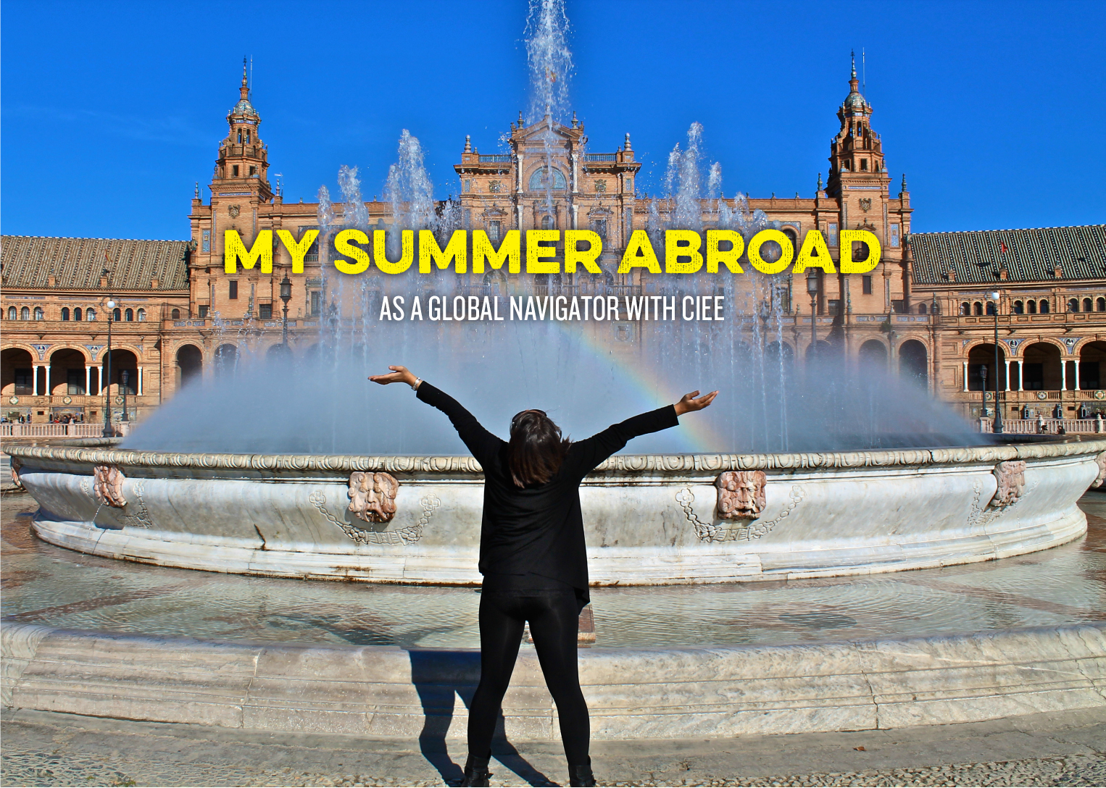

Your Name

Slide 2
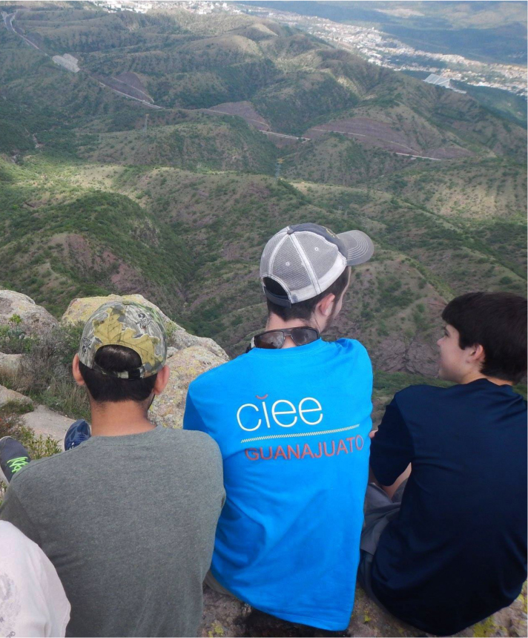
[INSERT A PHOTO HERE THAT BEST DESCRIBES THE LOCATION YOU WENT TO]
PROGRAM LOCATION
Main location of program:
Living Location:
Site visits:
Overnight trips:
CIEE Staff and Study Center:

Slide 3
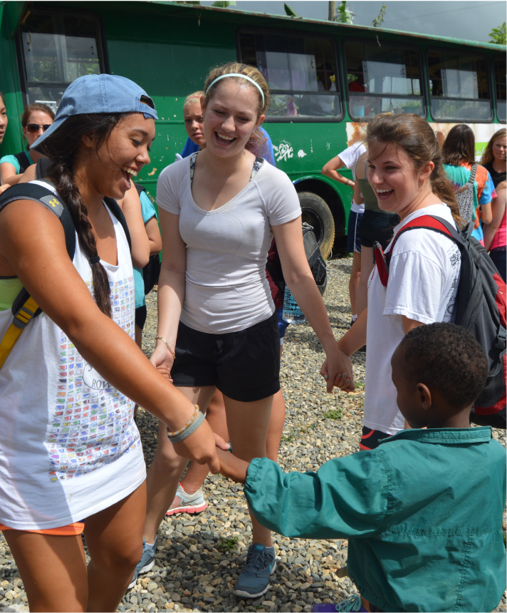
[INSERT A PHOTO HERE THAT BEST DEMONSTRATES WHAT YOUR EXPERIENCE WAS ABOUT]
LANGUAGE IMPROVEMENT
“Can do” statements
Experience in family:
Experience outside of family:
SERVICE PROJECT [IF APPLICABLE]
What I did:
Other activities:
CONTENT STUDIES [IF APPLICABLE]
What I studied:
Other activities

Slide 4
IN FAMILY OR DORM
Wake up time:
Breakfast:
Morning activities:
Lunch:
Afternoon activities:
Dinner:
Evening activities:
LANGUAGE CLASS
Time:
Typical Activities:
CULTURAL SEMINAR
Time:
Typical Activities:
SERVICE PROJECT
Time:
Typical Activities:

Slide 5
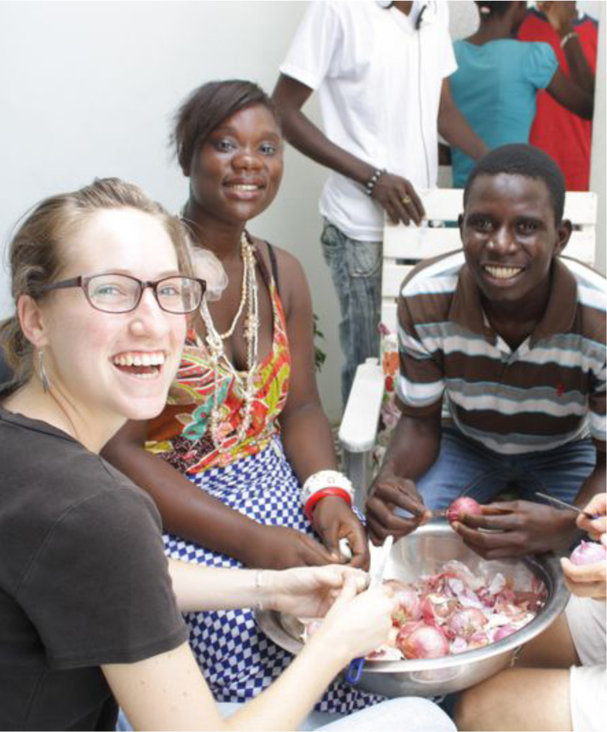
[INSERT A PHOTO HERE OF YOUR FAVORITE CULTURAL ACTIVITY OR OUTING DURING YOUR STAY]
Misunderstanding I had before the program:
Cultural learning:
Favorite cultural activity:
Changed view of my own culture:

Slide 6
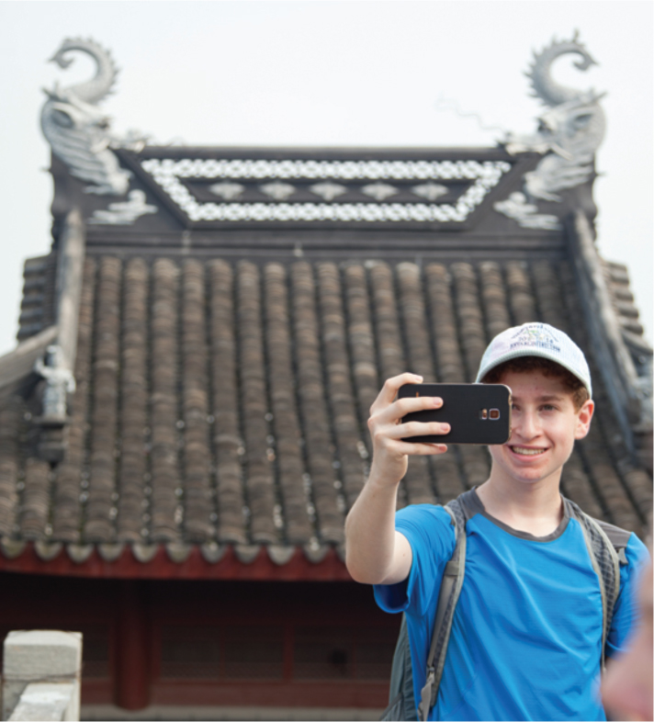
[INSERT A PHOTO HERE THAT BEST ILLUSTRATES YOUR HOST COUNTRY’S CULTURE]
What I thought of the US and my town before:
What changed about my view of the US:
What I thought of _______ before the program:
What changed about my view of ________:

Slide 7
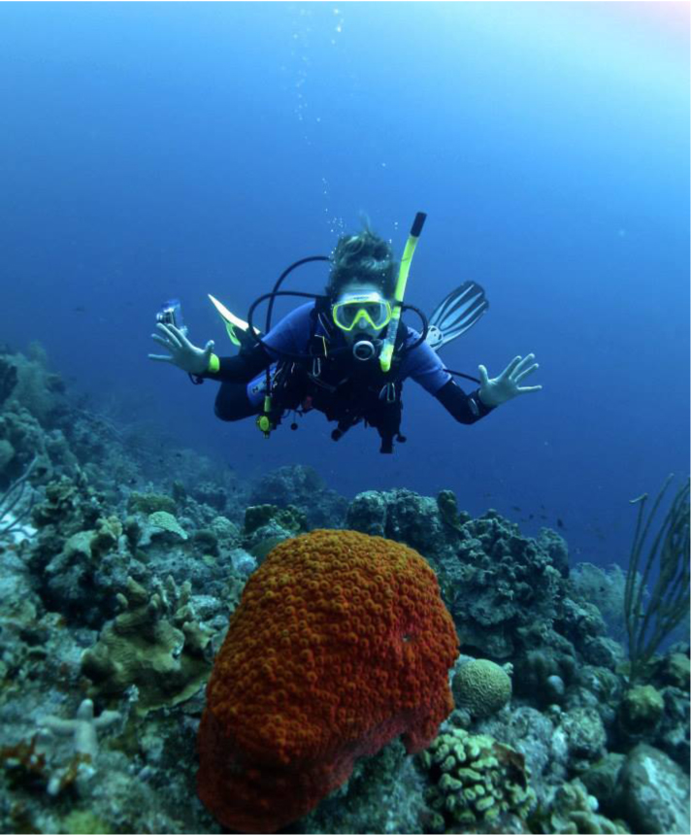
[INSERT A PHOTO HERE OF ONE OF YOUR FAVORITE MOMENT DURING YOUR STAY]
Where I heard about the program:
The online application was:
I knew (or did not know) other students at my school on my program:
The hardest part of the application was:

Slide 8
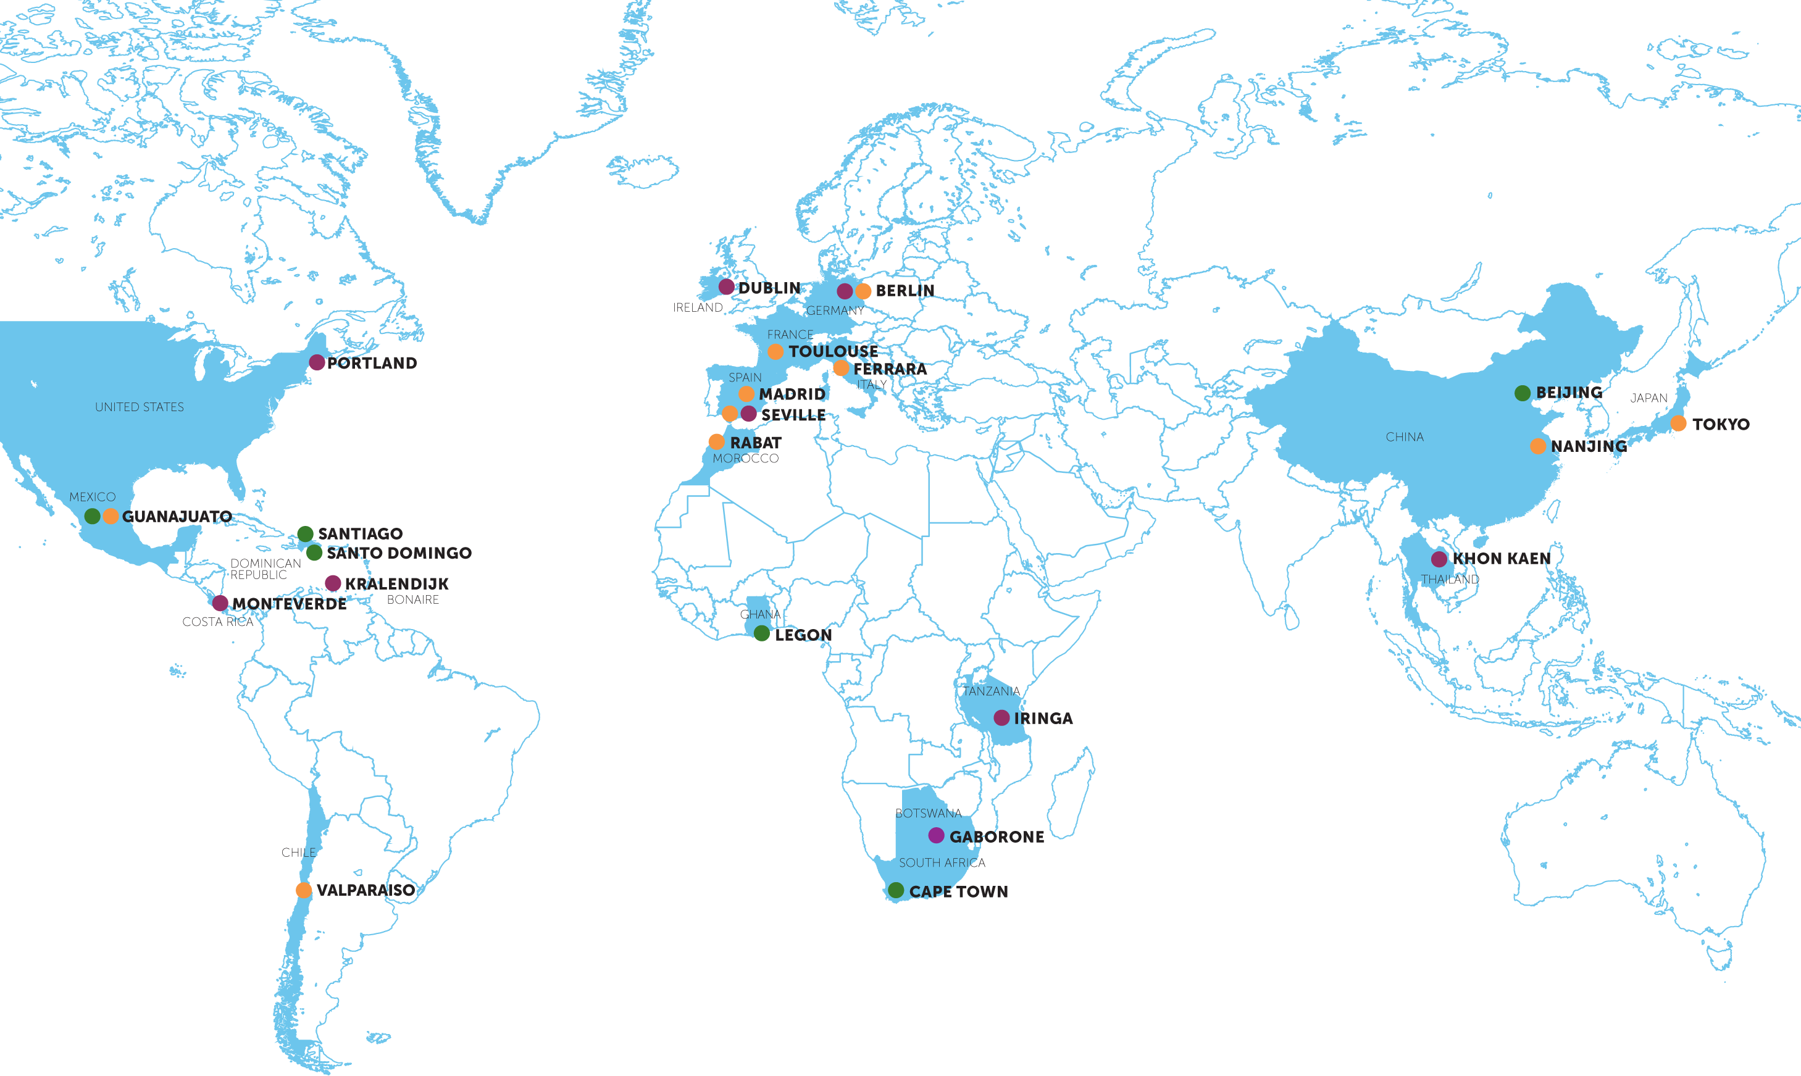

[SUM UP WHY YOU THINK STUDYING ABROAD IS IMPORTANT AND INVITE YOUR AUDIENCE TO CONSIDER PLACES THEY WOULD LIKE TO GO]
• LANGUAGE & CULTURE
• SERVICE & LEADERSHIP
• GLOBAL DISCOVERY
BONAIRE

Slide 9
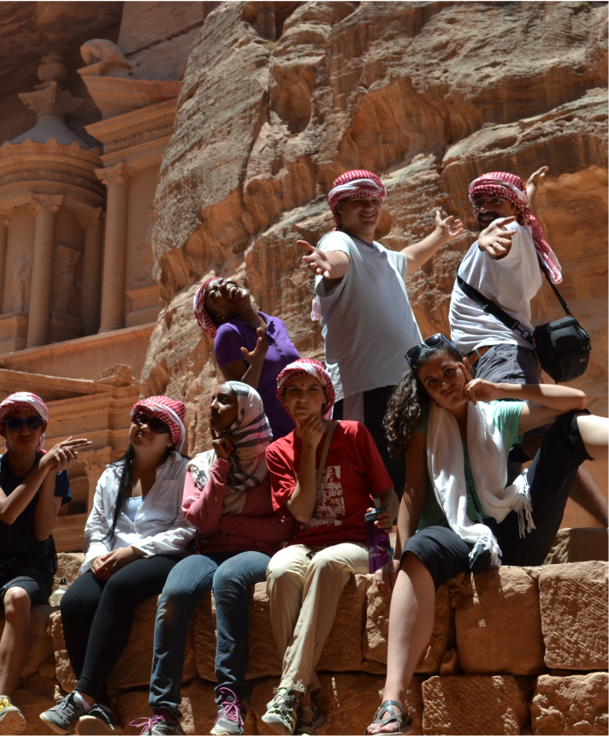
[INSERT A PHOTO HERE OF YOU AND YOUR GROUP]
College study abroad plan:
Service project plan for my own town:
Future life goals and how this experience changed them for me:

Slide 10
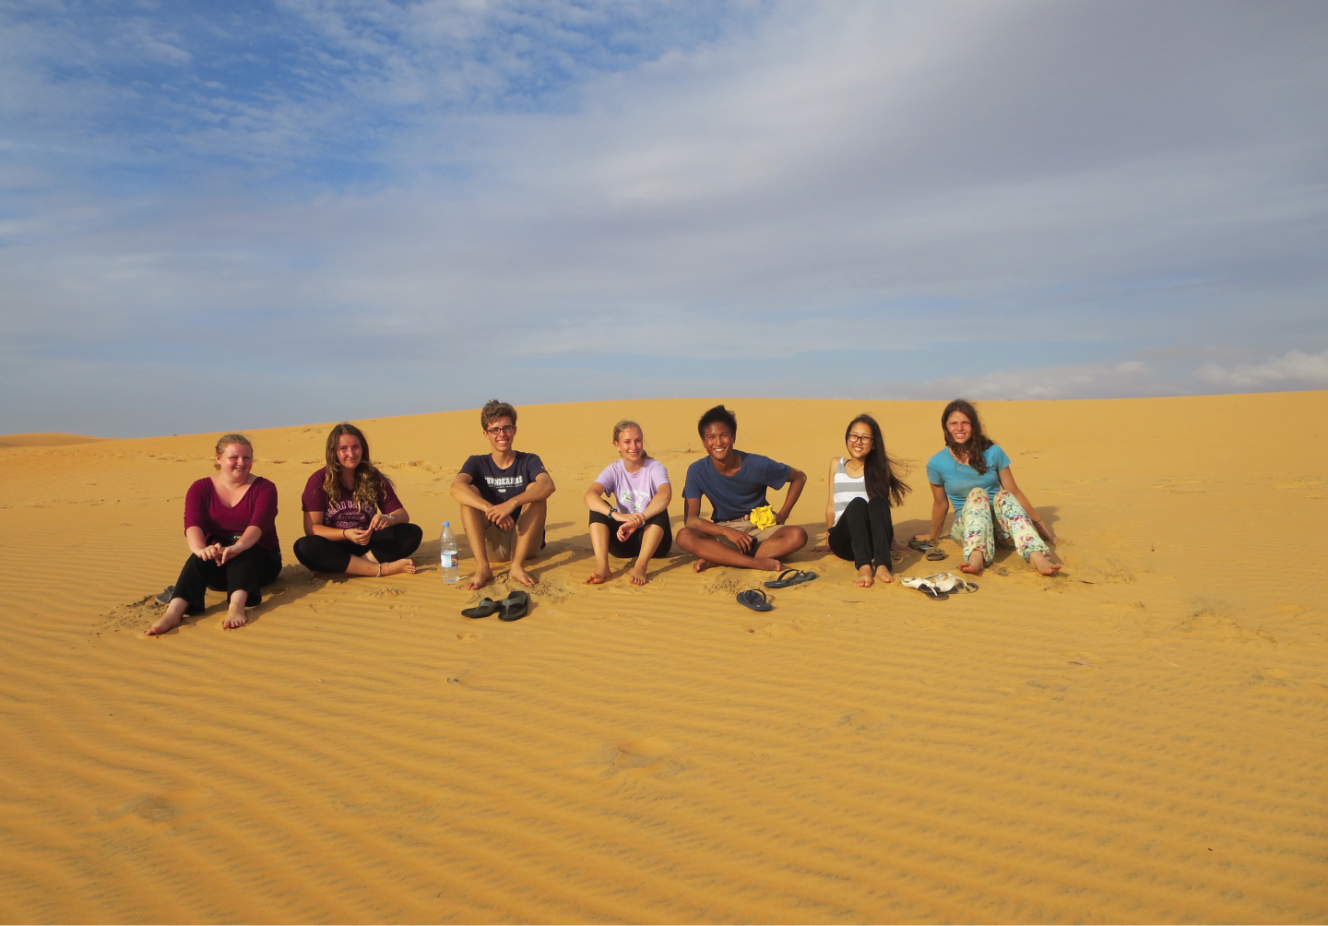
There is nothing like returning to a place that remains unchanged to find the ways in which you yourself have altered.”
—Nelson Mandela
“

