Slide 1
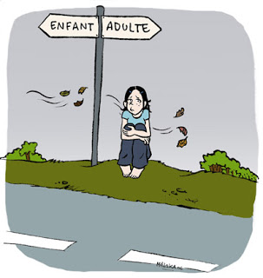
Chapter 12 Lesson One Page 364
Changes
During
Adolescence

Slide 2
What Happens During Adolescence?
During adolescence, you experience many physical, mental, emotional, and social changes.
adolescence The stage of life between childhood and adulthood, usually beginning somewhere between the ages of 11 and 15
Notes:
During your teen years, your body continues to grow and change, as do your interests.

Slide 3
Physical Growth
Teens go through puberty at different rates
puberty The time when you develop physical characteristics of adults of your own gender
Most females start puberty between the ages of 8 and 13.
Most males start
puberty between the ages of 9 and 14.
Notes:
Teens can vary widely in shape and size. You don’t need to be worried about these differences because you may be developing physically at a different rate than your friends and peers.

Slide 4
Physical Growth
Males | Females
Male hormone production increases. | Female hormone production increases.
Sudden, rapid growth occurs. | Sudden, rapid growth occurs.
All permanent teeth come into place. | All permanent teeth come into place,
Acne may appear. | Acne may appear.
Underarm hair appears. | Underarm hair appears.
Pubic hair appears. | Pubic hair appears.
Perspiration increases. | Perspiration increases.
External genitals grow. | Uterus and ovaries enlarge.
Shoulders broaden. | Breasts develop.
Muscles develop. | Hips become wider.
Sperm production starts. | Body fat increases.
Facial hair appears. | Ovulation occurs.
Larynx gets larger, and voice deepens. | Menstruation starts.

Slide 5
Mental Growth
As your brain grows, its ability increases to do complex reasoning and problem solving increases.
You learn to be more responsible.
You begin to make decisions based on your values and beliefs and understand that people have different points of view.
Notes:
Just like physical changes that teens experience, mental, emotional, and social changes happen at different rates, too.

Slide 6
Emotional Growth
You might become closer to your friends and feel less connected to your parents.
Being attracted to someone and feeling close to him or her emotionally is an important part of a healthy relationship.
As you mature, you will learn to manage your emotions in a positive way.

Slide 7
Expressing Emotions
You may feel many different emotions in a short period of time.
When you try to manage many strong feelings at once, it can feel overwhelming.
You might feel like lashing out at others or keeping your feelings hidden.
Notes:
When you try to manage many strong feelings at once, it can feel overwhelming. You might feel like lashing out at others or keeping your feelings hidden.

Slide 8
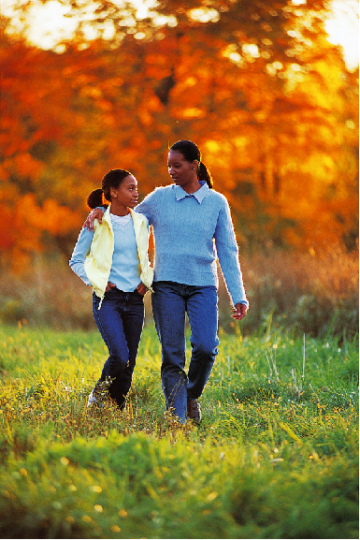
Talking to someone you trust can help you cope with strong feelings.

Slide 9
Expressing Emotions
Healthy Ways of Expressing Feelings
Write in a journal.
Exercise.
Draw.
Participate in a hobby.
Play music.
Talk to your friends, a sibling,
your parents, a counselor,
or another adult you trust.

Slide 10
Social Growth
Social growth is important because it can help you find your place in society.
The social connections that you make can help you develop friendships, find job opportunities, and get emotional support.
It is important to choose friends that will support and influence you in a positive way.
Notes:
Choosing friends that will support and influence you in a positive way will help you make good choices during your teen years.

