Slide 1
Chestnut Ridge Middle School
Monday,
May 15, 2017

Slide 2
May is
Better Hearing & Speech
Month!

Slide 3
Better Hearing & Speech
Fun Fact # 2
Teachers are most at risk for developing a voice disorder. Make sure to stay properly hydrated throughout the day!

Slide 4
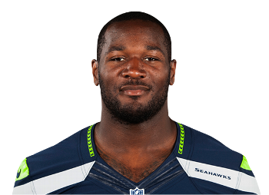
Better Hearing & Speech
Fun Fact # 3
Derrick Coleman, of the Seattle Seahawks, is the first legally deaf offensive NFL player.

Slide 5
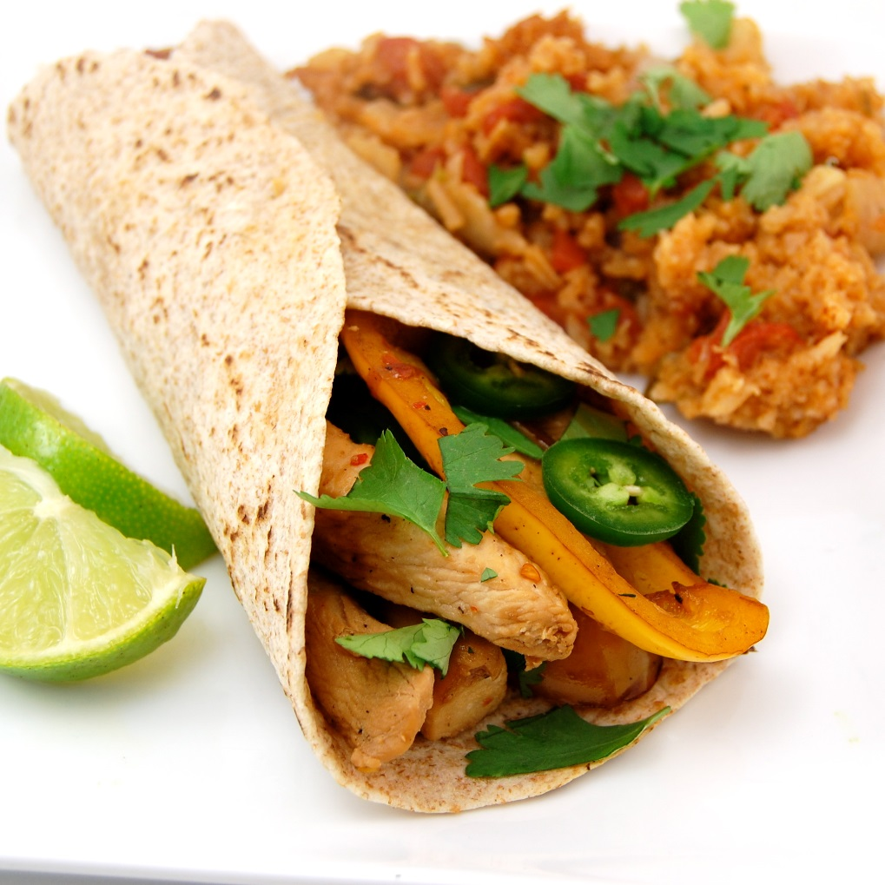
Cafeteria Menu
Monday, May 15
Chicken Fajitas
Brown Rice
Black Beans
Peaches

Slide 6
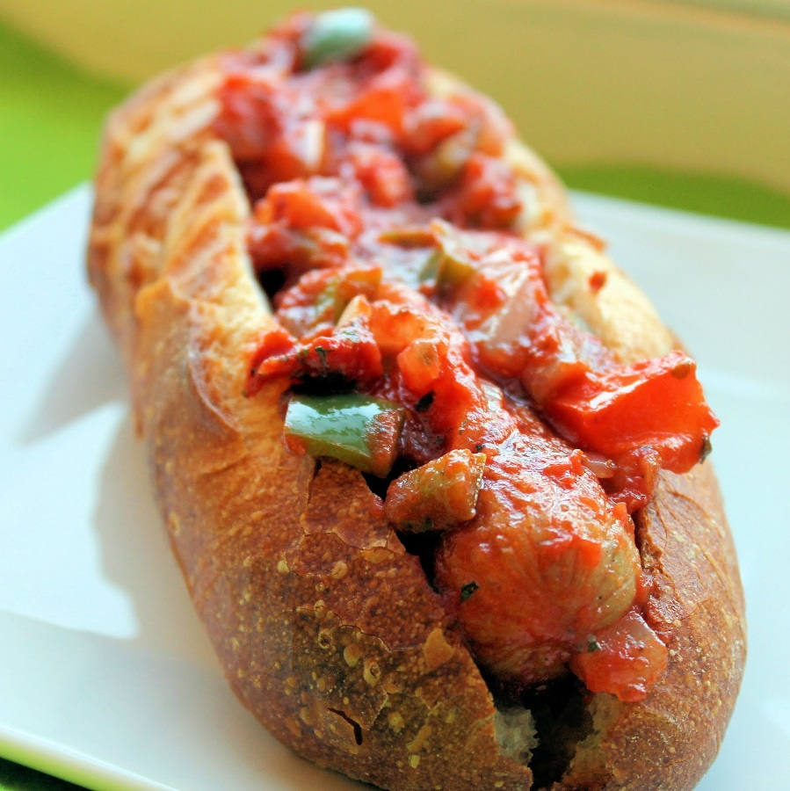
Cafeteria Menu
Tuesday, May 16
Sausage Parmesan Sandwich
Curly Fries
Peas
Apple Slices

Slide 7
6th Grade Homework Club
Tuesdays
Thursdays
Meetings are held in the IMC.

Slide 8
7th Grade Homework Club
Tuesdays
Thursdays
Room 202

Slide 9
8th Grade Homework Club
Tuesdays
Thursdays
Room 204

Slide 10
Digits Academy
After School
Tuesdays, Wednesdays & Thursdays

Slide 11
Yearbook Information
Yearbook sale ends on
May 31st!
All orders may be placed online.

Slide 12
6th / 7th Grade Class Council
Year In Review Meeting
Wednesday, May 17
After School – Until 3:45 PM
Room 109

Slide 13
7th / 8th Grade Band
Full Dress Rehearsal
Today – Room 123

