Slide 1
Chapter 22 The Battle for National Reform

Slide 2
Section 1 – Theodore Roosevelt & the Modern Presidency
The Accidental President
On September 6, 1901 an anarchist Leon Czolgosz assassinated Pres. William McKinley and Vice President Theodore Roosevelt became the nation’s youngest President at the age of 42.
Mark Hanna the Republican Party Boss said “Now look, that damned cowboy is President of the United States!”
Teddy Roosevelt’s upbringing & education were very different compared to his political contemporaries.

Slide 3
He was the youngest President at 42 (JFK was the youngest ELECTED Pres at 43 followed by Bill Clinton at 44)
He was from a very wealthy New York family (old money)
He was a Harvard graduate
He wrote books on history, political science, nature & he wrote an autobiography.
He was elected New York state Legislature, Governor of NY & Vice President of the US
He was appointed NY city police commissioner, civil Service Commissioner, & assistant Secretary of the Navy.
In 1898 he resigned as Assistant Secretary of the Navy & formed the Cavalry group The Rough Riders, he became a hero in the Spanish American War.
He was a champion of cautious, moderate change. Reform he believed was a vehicle for remaking American society and for protecting it against more radical challenges.

Slide 4
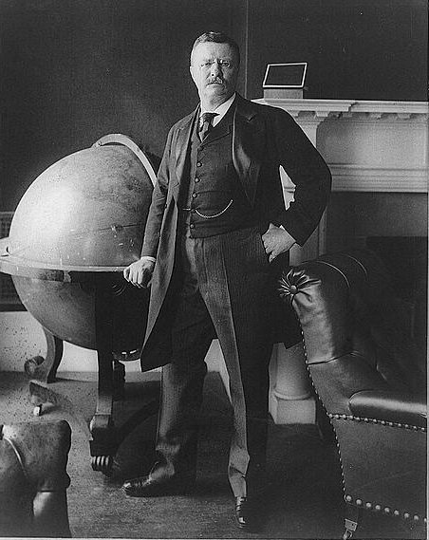

Slide 5
II. Government, Capital, Labor & the Square Deal
Roosevelt pledged a Square Deal to all Americans, which means fair treatment for business, workers & the public.
The 1902 Coal Strike – TR demanded that the owners meet with the union leaders at a White House conference. He threatened the owners that if they did not meet he would nationalize the mines.
The outcome of the conference was that the workers got a 9 hours day, a 10% wage increase & safer working conditions.
Teddy didn’t want to destroy corporations but he did want them to serve the public good. During his time in office he sent 44 anti-trust cases to court. The biggest of his cases was the NORTHERN SECURITIES COMPANY CASE
The NSC was a RR monopoly owned by JP Morgan, James T. Hill, EH Harriman & the banking house of Kuhn & Loeb. They owned all of the RR’s from Chicago West to the Pacific Ocean.
Supreme Court ruled in 1904 that the NSC DID restrain trade & was illegal under the Sherman Anti- Trust Act of 1890.
Supreme court also stated in its ruling that the Sherman anti-trust act should say “All unreasonable combinations of trade are illegal”

Slide 6
The passing of the EXPEDITION ACT OF 1903 gave anti-trust cases priority over other court cases.
With Roosevelt’s support Congress passed laws to strengthen the Interstate Commerce Act & laws to protect Public Health.
1903 – THE ELKINS ACT – forbade shippers from accepting rebates
1906 – THE HEPBURN ACT – authorized the ICC to set RR rates & to regulate other companies engaged in interstate commerce, such as pipelines, & ferries.
1906- MEAT INSPECTION ACT – required government inspection of meat shipped from one state to another
1906 – THE PURE FOOD & DRUG ACT – forbad the manufacture, sale or transportation of food & patent medicine containing harmful ingredients. The laws also required that container of food & medicines carry ingredient labels.
1910 – MANN-ELKINS ACT – placed telephone telegraph, cable, & wireless companies under the jurisdiction of the ICC (actually became law under Taft)

Slide 7
III. ROOSEVELT ON CONSERVATION & PRESERVATION
Roosevelt who found solace & reinvigoration in the West pushed hard to save the natural resources and put millions of acres of forests and water power sites on the National Parks list to protect them from development.
1902 – THE NEWLANDS RECLAMATION ACT – provided that money from the sale of public lands was to be used to build irrigation projects that would reclaim wasteland. Money from the sale of this reclaimed land & water from dams that were built would go into a fund to finance more reclamation projects.
By 1911 the SHOSHONE DAM & ROOSEVELT DAMS were built and over 200,000 acres of desert land were turned into rich farmland.
1908 – THE WHITE HOUSE CONSERVATION CONFERENCE – was held in May & had very successful results that included the formation of:
The National Conservation Commission
And the public was made aware of the need to conserve our natural resources. (History has shown that this topic has come up again in the 1970’s & once again in your lifetime.)
(Students should read on their own pages 596 to 598 in the 12th edition for more details on Roosevelt’s last years as President)

Slide 8
SECTION 2 – THE TROUBLED SUCCESSION I. TAFT TAKES OVER & ANGERS THE PROGRESSIVES
William Howard Taft was Roosevelt’s most trusted lieutenant & Teddy’s handpicked successor for the Presidency.
Among Taft’s progressive reforms were:
90 antitrust suits brought to the courts
MANN-ELKINS ACT passed
16th amendment became law (which is considered a progressive reform b/c it authorized a national tax based on income & on a graduated scale – those with more paid more.)
Taft angered the progressives when he sided with the conservatives over the following events.
PAYNE ALDRICH TARIFF – it raised tariff rates on imported goods to a new high; helping American industry but hurting the American people
Ballinger-Pinchot Controversy (pages 599 & 600) in short: GIFFORD PINCHOT was the head of the US Forest Service and an ardent conservationist. RICHARD BALLINGER was the Sec. of the Interior appt. by Taft.
Pinchot publicly stated that Ballinger was selling public lands to private companies for profit. Taft fired him.

Slide 10
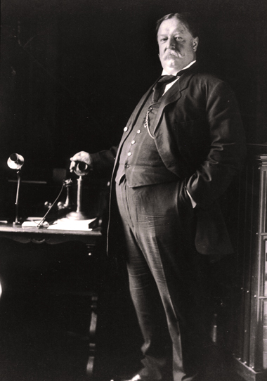

Slide 11
Roosevelt broke w/ Taft over the Pinchot controversy & he campaigned for progressive Republicans who opposed Taft in the 1910 congressional elections.
In congress after the progressives won a majority of seats they joined forces under GEORGE NORRIS OF NEBRASKA & ousted Speaker of the House “Uncle Joe” Cannon.
Uncle Joe was the leader of the Old Guard in the House of Representatives & tried to block Progressive reforms from his position as Chairman of the House Rules committee.
As part of the insurgency the Speaker lost the power to appoint members to certain committee & to appoint chairmen. This is now done by a policy of seniority & majority rule in the House.

Slide 12
“Uncle” Joe Cannon – upon his retirement from Congress 1923

Slide 13
II. Roosevelt versus Taft
By 1912 the conservative & progressive wing of the Republican Party were deeply divided.
In the Primary elections Teddy Roosevelt won every state including Taft’s own of Ohio.
At the Republican National Convention Taft’s forces refused to seat Roosevelt’s delegates. TR left the convention w/ his delegates & Taft won the nomination.
Roosevelt held his own convention a few weeks later & became the nominee of the BULL MOOSE PARTY
Oct. 14, 1912 – a man shot TR in the chest. His eyeglass case, muscular chest & folded speech in his pocket saved his life. He went on to finish his speech “with a bullet in my chest” and reinforced his image as a hero of the American people.
“New Nationalism” – graduated income & inheritance taxes, workers compensation for industrial accidents, regulation of the labor of women & children, tariff revision & firmer regulation of corporations.

Slide 14
With the Republican Party split between Taft & TR the Democratic Party joined forces & backed the progressive governor of New Jersey, WOODROW WILSON.
Wilson's background:
Wilson was born in post Civil War Virginia;
his father was a minister.
He graduated from Princeton, received his Masters from the University of Virginia & earned a PH.D. from Johns Hopkins University.
He was a professor of History at Bryn Mawr & Princeton.
In 1902 he was elected Pres. of Princeton University
& in 1910 he was elected governor of New Jersey.

Slide 16
As governor he began a direct primary in NJ, stopped corrupt business practices, & regulated public utility companies.
Eugene V. Debs, President of the American Railway ran for President on the Socialist Party ticket (last chapter)
Results of the election:
Wilson = 435 electoral votes
Roosevelt = 88 electoral votes
Taft = 8 electoral votes (he carried Utah & Vermont)
Debs won over 1 million popular votes but did not get any electoral votes.

Slide 18
Section 3 – Woodrow Wilson & the New Freedom I. Woodrow Wilson’s New Freedom
Wilson, like Brandeis, believed that bigness was both unjust & inefficient, that the proper response to monopoly was not to regulate big business but to destroy it.
1913 – UNDERWOOD TARIFF ACT – reduced tariffs to their lowest levels in 50 years. To make up for the revenue lost the bill imposed a graduated income tax. (Those with more pay more to the gov’t.)
1913 – FEDERAL RESERVE ACT – created a three tiered banking system.
Federal Reserve Board, a group appt. by the President and charged w/ running the system, setting interest rates & controlling the amount of $$ in circulation.
12 Federal Reserve Banks – that are “bankers” banks
Private Banks that could borrow from the Federal Reserve at interest rates set by the Board.

Slide 19
1914- THE CLAYTON ANTI-TRUST ACT – this act extended the Sherman Antitrust Act of 1890 by using clearly stated terms.
Companies can not sell goods below cost to drive competitors out of business
Nor could companies buy competing companies stock to create a monopoly
Provided that labor had the right to strike so long as property was not irreparably damaged.
1914 – FEDERAL TRADE COMMISSION (FTC) – authorized to investigate corporations & issue “cease & desist order” to those engaged in unfair or fraudulent practices & use the courts to enforce its rulings.
FTC – targeted mislabeled products & false claims

Slide 20
The democrats suffered major loses in the House in the Congressional Elections of 1914. Afraid of the movement away from Progressivism, Wilson began to push for even more reforms.
He appointed LOUIS BRANDEIS to the Supreme Court (he was the first Jew but also the most progressive to serve there.
FEDERAL FARM LOAN ACT – provided low interest loans to farmers
THE ADAMSON ACT – reduced the workday for RR workers from 10 to 8 hours w/ no cut in pay
FEDERAL WORKMEN’S COMPENSATION ACT – provided benefits to federal workers injured on the job
KEATING OWEN CHILD LABOR ACT – outlawed the interstate sale of products produced by child labor
1918 – The Supreme Court ruled this law unconstitutional because it restricted commerce instead of directly outlawing child labor.
It was not until the 1930’s & Franklin Roosevelt that a law was passed outlawing child labor in the USA

Slide 21
Wilson refused to support the national woman suffrage movement.
In 1916 at his second inauguration the National Woman’s Party w/ Alice Paul as their leader (a Jersey Girl) they women chained themselves to the gate of the White House in protest.
These women were arrested and brutalized in jail.
See film “Iron Jawed Angels” for example
During WWI, women took over many jobs that were once held by men & it was at this time the opposition to women’s suffrage was weakened.
19TH AMENDMENT – gave women the right to vote in 1920
**** Note: WORLD WAR I BROUGHT AN END TO THE PROGRESSIVE MOVEMENT IN THE US. ANOTHER PERIOD OF REFORM DID NOT EMERGE IN OUR SOCIETY UNTIL THE GREAT DEPRESSION & THE PRESIDENCY OF FRANKLIN DELANO ROOSEVELT.

Slide 22
The 2nd ½ of the chapter deals w/ foreign affairs under these Presidents.
SEC. 4 – The “Big Stick”: America & the World, 1901 – 1917
I. Roosevelt & “civilization”
Teddy believed that an important distinction existed between the “civilized & “uncivilized” nations of the world.
Civilized Nations were: dominantly white, Anglo Saxon or Teutonic; they produced industrial goods and had the right to intervene in the affairs of a “backward” nation to preserve order & stability.
“Uncivilized Nations” were: generally nonwhite, Latin or Slavic (African & Asian, too) , behind in economic development, suppliers of raw materials & markets for the industrial nations.
According to TR Japan was a “civilized” nation because it was a rapidly industrializing society.

Slide 23
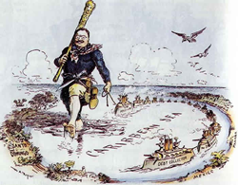
Teddy portrayed with his Big Stick

Slide 24
RUSSO-JAPANESE WAR OF 1904-1905 – Japan defeated Russia & the treaty ending the war was brokered by Teddy Roosevelt at Portsmouth, New Hampshire.
Following the war, the Japanese began to block American trade with the territories it controlled.
Teddy sent 16 battleships on a world wide tour (The Great White Fleet) to remind the Japanese of the potential might of the US.
The Iron Fisted Neighbor & the Panama Canal
When Venezuela defaulted on some loans navies from Germany, Britain & Italy landed off the coast & the German navy began firing on the Venezuelan port.
US threatened military involvement & forced the European Navies to withdraw.

Slide 25
Roosevelt issued the Roosevelt Corollary to the Monroe Doctrine. It said:
The US would oppose any European intervention in the Western Hemisphere
The US would intervene itself in the domestic affairs of its neighbors if those neighbors proved unable to maintain order & national sovereignty on their own.
AS a result of the Roosevelt Corollary the US began to interfere in Latin American countries on a regular basis.
1903 – Dominican Republic – could not pay $22 million in debts. US takes over their custom houses & begins paying off their debts. (over 30 years US troops were in DR)
1902 – CUBA –had to agree to the Platt Amendment which gave the US the right to prevent any other power from intruding in Cuba.
1906 – American troops landed in Cuba to quell fighting there and stayed for 3 years.
1903 – With US backing (troops from the U.S.S. Nashville) Panama succeeded in breaking off from Colombia
US immediately recognized the new republic & started negotiations on building a canal
1904-1914 – the Canal was built.
Panama Canal Zone remained in US hands until the 1970’s.

Slide 26
III. Taft & “Dollar Diplomacy”
William Howard Taft worked to advance the nation’s economic interests overseas. His Sec. of state – Philander C. Knox – worked aggressively to extend American investments into less- developed regions.
1909 – Nicaragua – revolution broke out in N. & the US quickly sided w/ the insurgents. American troops were sent in to seize the customs houses.
US banks loaned $$ to the new country to keep the financial leverage over it.
2 years later the Pro-American gov’t. faced an insurrection; American troops were landed again & this time remained there for more than a decade.

Slide 27
IV. Diplomacy & Morality in Foreign Affairs under Wilson
Wilson faced international challenges of a scope & gravity unmatched by those of any president before him.
1916 – when the Dominicans refused to accept a treaty w/ the US Wilson sent in the military and they stayed there for 8years.
1915 – Marines landed in Haiti to quell a revolution – American troops remained there until 1934.
1918 – when the Germans were in position to take the Danish West Indies – Wilson bought them and renamed them the Virgin Islands.

Slide 28
B. Wilson’s Moral Diplomacy was evident in his dealings with Mexico.
For many years American businessmen had been establishing an enormous economic presence in Mexico under Mexican dictator Porfirio Diaz.
1910 – Diaz was overthrown by the popular Francisco Madero who promised democratic reform but who was hostile to American businesses in Mexico.
The US encouraged a reactionary General VICTORIANO HUERTA to depose Madero.
Taft administration supported Huerta even though Madero was brutally murdered but he was leaving office before he could recognize the Huerta government.
Upon taking office Wilson announced that he would NEVER recognize Huerta’s “government of butchers”.

Slide 29
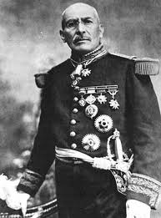
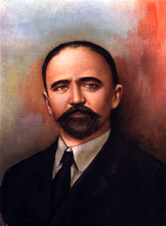
VICTORIANO HUERTA
Porfirio Diaz
Francisco Madero

Slide 30
1914 – Mexican forces arrested 14 sailors from the USS Dolphin; Wilson used this as an excuse for capturing the port of Veracruz. At the same time Rebel forces under VENUSTIANO CARRANZA took Mexico City & Huerta fled the country.
1915 - after much debate Wilson recognized the new government under Carranza causing Mexican Rebel PANCHO VILLA to attach American cities along the border.
General John J. Pershing led an American army into Mexico to hunt for Pancho Villa
US army never found Villa and with World War I being fought all over Europe – American troops were pulled out of Mexico.

Slide 31
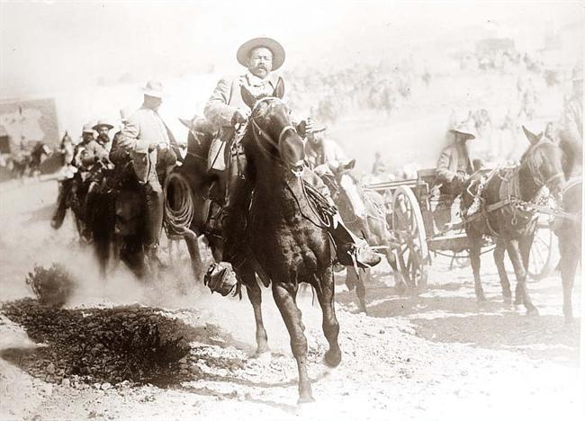
PANCHO VILLA

