Slide 1
Chapter 31: Conservatism
By: Ai Hue Nguyen, Morgan Riccobene, Vasiliki Dinoulis, and Julia Dunn
Period 3

Slide 2
Pragmatic Liberalism
Nixon’s first term of presidency began on a hopeful note, as Nixon promised to bring the country peace and respite, in contrast to the turbulence of the 1960s. Pledging to unite the country, Nixon focused on making the federal beaurocracy more efficient, expanding federal programs and responsibilities in some areas.
Nixon’s liberal programs:
  Affirmative Action—In regards to civil rights, Nixon was the first president to adopt a policy of affirmative action. The policy included both minorities and women; the goal was for the federal government to achieve the “prompt and full utilization of minorities and women at all levels in all segments of its work force”.
  Occupational Safety and Health Administration—Nixon approved the creation of the Occupational Safety and Health Administration, whose purpose was to reduce workplace injuries.
  Environmental Protection Agency—Nixon also oversaw the creation of the Environmental Protection Agency (EPA), the federal organization responsible for supervising environmental affairs. Additionally, he supported automatic cost-of-living increases to Social Security.
  Clean Air Act—This act, signed by Nixon, provided the basis for limiting smog and other air pollutants.

Slide 3
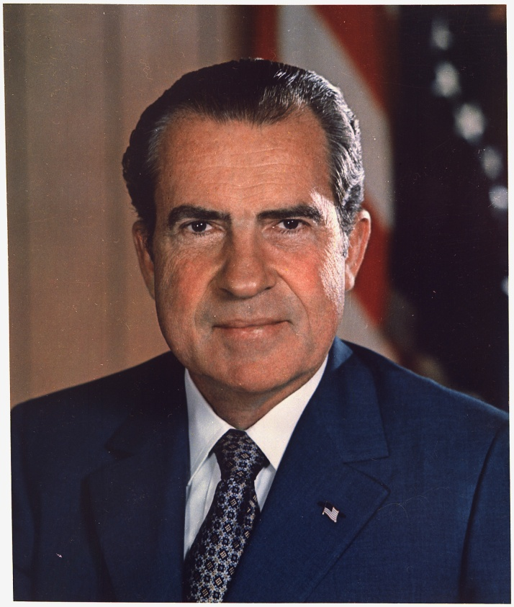
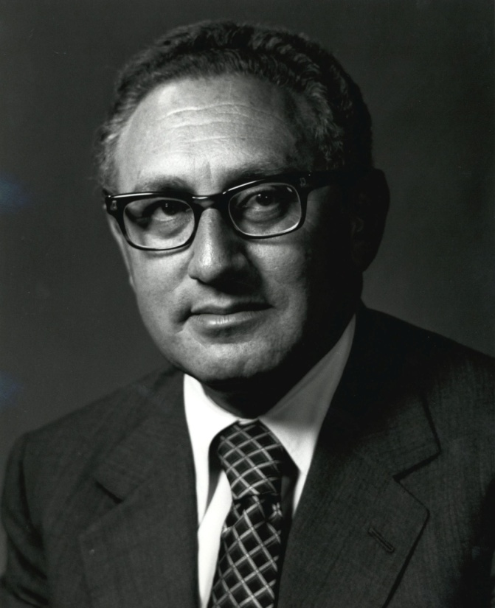
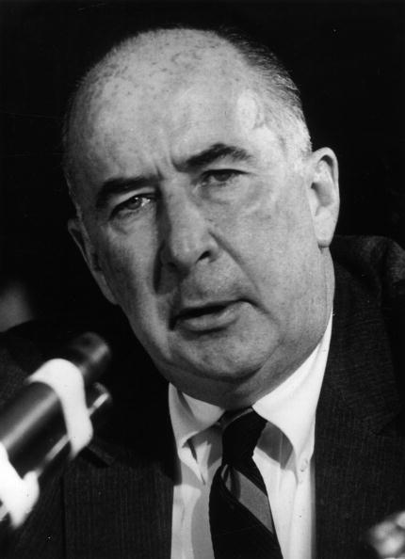
President Richard M. Nixon
Nixon’s national security advisor during his first term—Henry Kissinger
Nixon’s attorney general—John Mitchell

Slide 4
Pragmatic Liberalism
One of Nixon’s domestic goals was a commitment to shift social problems to state and local governments (not the federal government).
Nixon also aimed to increase revenue spending between federal, sate, city, and county governments.
He allowed the Supreme Court to handle the issue of segregation in schools.
  The Supreme Court ruled against segregation, causing southern white voters to focus their resentment on the Supreme Court instead of Nixon.
  This demonstrated the calculated nature of Nixon’s civil rights policy.

Slide 5
Détente
Nixon and his national security adviser, Henry Kissinger, had grand plans for foreign policy—the main focus of Nixon’s presidency.
Nixon’s program to improve relations with the Soviet Union was known as détente.
  Nixon and Kissinger saw China as the first step to achieving détente with the Soviet Union. They believed that resuming relations with China would force better relations with the Soviet Union.
  In February 1972, Nixon paid a visit to China and met with its communist leaders, ending more than two decades of Sino-American hostility.
  The Soviets , who regarded China as a dangerous adversary, reacted by agreeing to an arms control pact with the United States. This resulted in the signing of the SALT (Strategic Arms Limitations Talks) I treaties. These treaties involved reductions in the number of ballistic missiles.

Slide 6
Détente
The SALT I agreements:
  Limited superpowers to two hundred antiballistic missiles (ABMs) apiece
  Froze the number of offensive ballistic missiles for a five-year period
  Recognized the existing Soviet lead in missiles
  Were more important as symbols than as concrete events; demonstrated that the United States and the Soviet Union were trying to achieve settlement of their difference through peaceful means

Slide 7
Ending the Vietnam War
Nixon’s three-part plan to end the conflict in Vietnam included:
  Gradual withdrawal of American troops, accompanied by the training of South Vietnamese troops to take over the combat role
  Renewed bombing
  Hard line in negotiations with Hanoi
Renewed bombing was the most controversial aspect of Nixon’s plan. In spring 1969, Nixon secretly ordered raids on communist supply lines in neutral Cambodia. In April 1970, he ordered air and ground strikes on Cambodia.
  The U.S. invasion of Cambodia precipitated the Kent State incident, in which rioters at Kent State University firebombed an ROTC building. National guard troops, sent in to control the situation, opened fire, killing four and wounding eleven.
  Towards the anti-war demonstrators, Nixon displayed an attitude of little sympathy, which the American public generally seemed to share. More blame was placed on the protestors than on the national guard for the deaths at Kent State.

Slide 8
Ending the Vietnam War
Negotiations with Hanoi were the most successful part of Nixon’s plan. Kissinger, Nixon’s national security adviser, began secretly meeting with the North Vietnamese foreign minister, Le Duc Tho, in the summer of 1969.
  The two sides neared agreement; however, South Vietnamese objections prevented a settlement before the election of 1972. When the North Vietnamese tried to make last-minute changes, Nixon responded by ordering a series of heavy B-52 raids on Hanoi, which finally led to the signing of an agreement. In this agreement, the United States promised to remove its troops from South Vietnam within sixty days in exchange for the release of all American prisoners of war.
  Once Nixon became involved in the Watergate scandal, his control over foreign policy weakened. Thus, the communists seized the opportunity, mounting a major offensive and completing their takeover in Vietnam in just weeks. The American effort to preserve South Vietnam from communism proved to be a tragic failure.

Slide 9
The Watergate Scandal
Nixon was extremely fearful of leaks of information about American foreign policy. When leaks occurred, he grew outraged and demanded that they be stopped.
The White House established an informal office of secret surveillance, its members known as “plumbers”.
  The original purpose of the office was to investigate national security breaches. However, during the presidential campaign of 1972, it evolved into spying on Nixon’s Democratic opponents and engaging in political dirty tricks.
  Five of the “plumbers”’ were arrested during a break-in at the headquarters of the Democratic National Committee at the Watergate office complex in Washington. The Nixon administration went through great lengths to cover up Nixon’s connection to the break-in.

Slide 10
The Watergate Scandal
Nixon’s cover-up lasted long enough to ensure his reelection victory against George S. McGovern, the Democratic nominee, who was perceived as an anti-establishment candidate.
However, the scandal began unfolding over the next few months, and the Senate appointed a special committee to investigate what became known as the “Watergate scandal”.
  John Ehrlichman and H.R. Haldeman, close Nixon associates, were forced to resign as the events of the scandal began to surface.
Nixon’s guilt was proven by tape recordings of conversations in the Oval Office, which Nixon originally tried to withhold but which the Supreme Court ruled had to be turned over.
  Serving as special prosecutors in the Watergate case were Leon Jaworsky, appointed to replace Archibald Cox whom Nixon fired, and Judge John Sirica.
The culmination of the scandal was Nixon’s resignation from presidency.
Overall, the scandal demonstrated the strength of America’s basic governmental institutions, showing that investigative reporting could reveal even the most closely guarded executive secrets and that the impeachment process made Nixon’s fate inevitable.

Slide 11
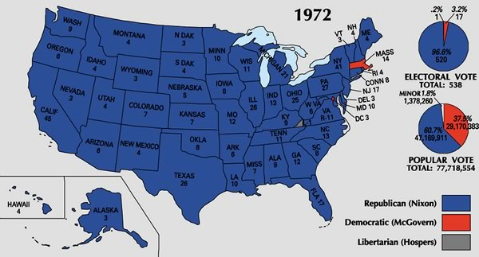

Slide 12
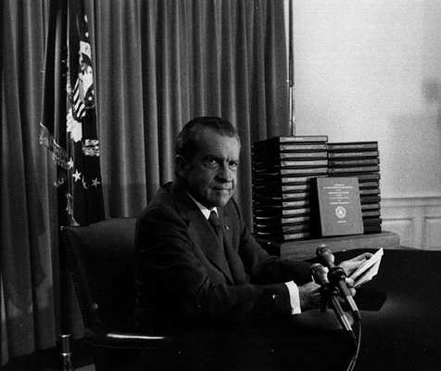
The Watergate Scandal
This photo shows Nixon in one of his desperate gambles to avoid impeachment for the events of the Watergate scandal.

Slide 13
War and Oil
On October 6, 1973, after experiencing a decade of tension with the Israelis, Arab nations Egypt and Syria launched a surprise attack against Israel. The Arabs won early battles but soon lost their initiative and would have succumbed to defeat by the Israelis if Nixon and Kissinger, fearing that an Israeli victory would further destabilize the Middle East, had not intervened.
The American diplomatic victory was short-lived, however, as it was quickly followed by the Arab oil boycott, which was precipitated by the Yom Kippur War. The boycott led to major economic crisis in the U.S..

Slide 14
War and Oil
The Arab Oil Boycott:
  As a circumstance of the Yom Kippur War, the Arab members of the Organization of Petroleum Exporting countries (OPEC)—the organization most responsible for raising petroleum prices in the 1970s—began cuts in oil production in an effort to get Israel to return the lands it had taken in 1967.
  When Nixon responded by sending an emergency aid package to Israel, Saudi Arabia cut off oil shipments to the United States.
The Arab oil embargo had an extremely detrimental effect on the American economy.
  Led to dramatic increase in international oil prices, the greatest challenge faced by the Nixon administration
  Most grave consequence was inflation throughout America
Nixon responded by asking Americans to take a series of temporary measures, including turning down thermostats in offices and homes and avoiding driving for enjoyment.
In March, Kissinger negotiated an Israeli pullback in the Sinai, resulting in the end of the Arab oil embargo. The American public relaxed, and gasoline grew plentiful once again.
However, the energy crisis continued to be a problem after the embargo. The United States, which had previously based its life on abundance and expansion, was now faced with the reality of limited resources and economic stagflation.

Slide 15
The Great Inflation
The price spike from the October War was the first of the “Oil Shocks” of the 1970’s
A Primary contributor to growth of the Amer. economy after WWII was cheap energy
GNP more than doubled between 1950 and 1973. Gas was about 35 cents a gallon. Oil prices quadrupled in 1973-1974. This put the high GNP at risk because energy was used for all production and transportation, and a few services. That means the price in all of these went up as the price of oil did.

Slide 16
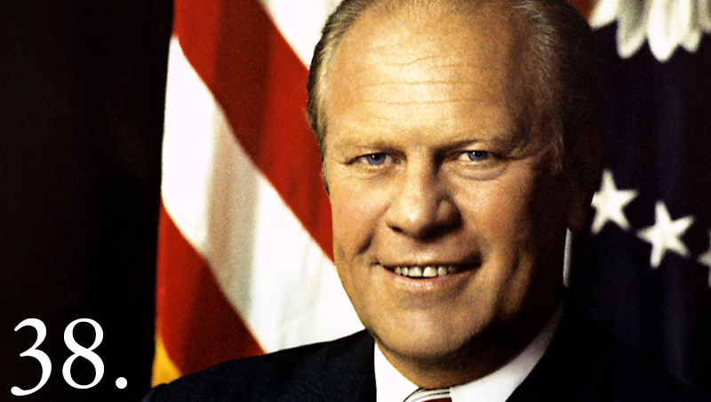

Slide 17
The Great Inflation
President Gerald R. Ford, who followed Richard Nixon as president, responded belatedly to the economic crisis by proposing a tax cut to stimulate customer spending. This helped, but resulting budget deficit prevented a return to full economic health.
1979 Iranian Revolution outbreak and the overthrow of the shah set off another oil shock.
In late 1979, President Carter’s appointee and the leader of the Federal Reserve Board, Paul Volcker, began a sustained effort to stop inflation by mandating increased bank reserves to curtail the amount of money in circulation. (Tight-money policy). This ended up making inflation worse by driving up interest rates.

Slide 18
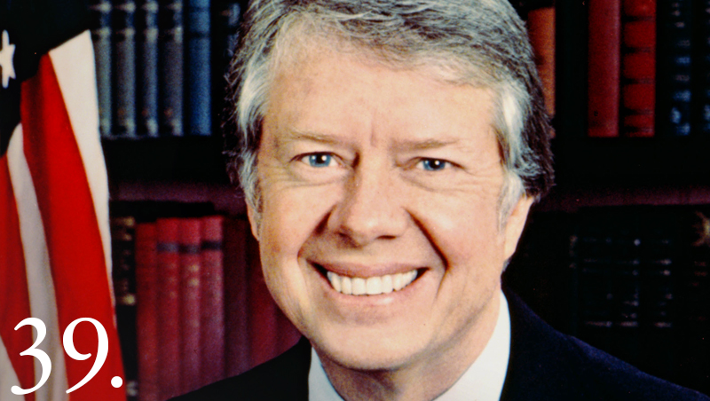

Slide 19
The Shifting American Economy
Inflation and the oil shocks brought significant changes to American business and industry in the 1970s.
  Most obvious result was slowing rate of economic growth. American industry began to lose its position of primacy in world markets. U.S. declined in relation to Japanese and Western European competitors.
    Most serious losses were in industries United States had once led in compared to the world. Advanced technology and government subsidies allowed other nations to produce steel much more efficiently that the US. Resulting in American firms closing down due to being obsolete at the end of the 1970s. This idled thousands of workers (unemployed).
Foreign competition did more damage in the automobile industry. Oil shocks left a demand for small, energy efficient cars that Japan and Germany were able to produce.

Slide 20
The Shifting American Economy
Labor movement:
Industrial unions such as United Automobile Workers (UAW) lost members steadily in the 1960s and 70s. Public employee unions enjoyed rapid growth and acceptance.
The Great Society legislation, the baby boom had a resulting need for many more teachers, and the growth of social agencies on the state and local level opened up new jobs for social workers, teachers, and government employees.
By end of 1980’s National Education Association (NEA) became the nation’s largest single union w/ 2 mil. Members. Rise of public employee unions also opened the way for greater participation by African Americans and women than in the older trade and industrial unions.

Slide 21
The Shifting American Economy
As public employee unions prospered from the shifts in the American economy in 1970s, so did many American corporations.
  Multinationals that had emerged in the boom years of the 1960s continued to thrive. IBM sold computers all over globe Growth of conglomerates- huge corporations that combined many dissimilar industrial concerns- accelerated as companies such as Gulf & Western and the Transamerica Corporation diversified by buying up Hollywood studios, insurance companies, and recreational equipment manufacturers.
Most profitable new trend of 1970s was the growth of high-technology industries.
  Computer companies and electronics firms grew at a rapid rate. Especially after the silicon chip; a small, thin microprocessor able to perform complex calculations almost instantly, was developed.
The result was geographic shift of American industry from the east and Midwest to the Sunbelt.
  Electronics manufacturers flourished in California, Texas, and North Carolina, where they grew up near major universities.
  Many new concerns were lured to the Sunbelt.
  At the same time, the decline of steel and auto industries was leading to mass unemployment and economic stagnation in industrial North.

Slide 22
A New Environmentalism
The oil shocks had another effect: they injected new life into the environmental movement.
Congress pressed automakers to improve the fuel efficiency of their cars.
The 1975 Energy Policy and Conservation Act set corporate standards for gas mileage.
  Manufacturers who failed to achieve mandated averages had to face stiff fines and other sanctions.
    Between high prices and the federal requirements, American drivers squeezed more miles out of each gas tank.

Slide 23
A New Environmentalism
Environmentalists and consumers began searching for alternative energy sources.
Solar power was clean and endlessly renewable, but solar panels and other solar technologies were expensive and clouds would make the energy intermittent.
Hydropower- electricity by waterfall- was more efficient but most dams were already built upon.
Wind power only worked where the breeze flowed without interruption, and that is only in places where few lived.
Coal power was reliable, proven, and cheap; but it caused pollution and was dangerous for miners.
Some advocated for Nuclear power. Its fuel, uranium, was essentially inexhaustible and nuclear reactors released neither toxic gas nor greenhouse gases during normal operation. This means it couldn’t contribute to global warming-a rise in global temperature that was beginning to worry some scientists. However, Nuclear power is not clean, and is expensive.
  Nuclear power made environmentalists nervous because its waste is radioactive and remains so for thousands of years. Contamination of water supplies was a fear and nuclear reactors sometimes malfunctioned in terrifying ways.
  March 1979, a reactor at Three Mile Island nearly melted down when cooling systems failed. Grave second thoughts on using nuclear power were inspired since the plant could have exploded. In Chernobyl in Soviet Ukraine, a much more severe accident occurred where radiation was released into the atmosphere killing many, which worsened fears.

Slide 24

A New Environmentalism
The debate over alternative energy sources was part of a larger debate on environment.
Earth Day, first celebrated April 1970, became an annual event to consider the effect of human actions on the environment.
Groups such as Sierra Club and Friends of the Earth lobbied to reinforce antipollution laws, clean up toxic wastes, and to increase gas mileage standards. Business associations resisted measures because they were too restrictive and expensive.
  Results were mixed. Congress strengthened the Clean Air Act and created a federal “superfund” for toxic cleanups in 1980. But oil imports kept rising by some 50% between 1973 and 1979.

Slide 25
The Changing American Family
Family life had several shifts after 1970. The most notable was a decline in the number of families with two parents and one or more children under 18. There was a sharp increase in working women, including wives and mothers, and the wage gap between sexes narrowed, but women still earned less than men. By the end of the 1980s, in only one two-parent family out of five was the mother solely engaged in raising the children. This means that in the spring of 1980, the prime rate reached 20% percent. Some households had stay out home fathers, however the great majority of families had both parents working outside of the home.
The 1950s sense of a “nuclear family” no longer prevailed by the 20th century’s end. The number of married couple households with children dropped from 30 to 23 percent from the 1970s to 2000, the divorce rate doubled between mid-1960s and late 1970s, the number of unmarried couples doubled in the 1990s, and the number of adults living alone surpassed the number of adults married with children for the first time in American history.
There was an increase in births to women over 30 and to single mothers, who composed 75% of households by 2000. All of this caused conservatives to call for change. Many people never married or delayed marrying until much later in life.

Slide 26
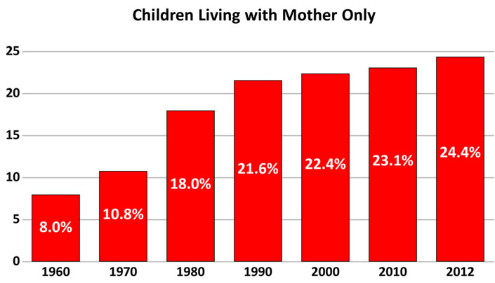

Slide 27
Gains and Setbacks for women
There was a rapid movement of women into the labor force in the 1970s. However, women still didn’t earn as much as men. Women entered corporation boardrooms, became presidents of major universities, were admitted to the nation’s military academies; and entered blue-collar, professional, and small business fields traditionally male dominated. Reagan’s appointment of Sandra Day O’Connor to the Supreme Court in 1981 marked a historic first, and Bill Clinton doubled the amount of women on the Court by selecting Ruth Bader Ginsburg.
However, most women still worked in female dominated fields. Those who entered male-dominated jobs couldn’t advance beyond midlevel executive status. In 1990, only 4.3% of corporate officers were women. The economic boom of the 1990s, however, led to a steady increase of women executives. The most encouraging development for women was business ownership.
By 2004, women’s wages still averaged only 76.5% of men’s earnings. Feminists had once hoped to close the wage gap by the year 2000, but experts predicted women wouldn’t reach pay equality with men until 2018.
The most encouraging development for women was business ownership.

Slide 28
Gains and Setbacks for women
The women’s movement had two goals beyond economic opportunity. The first was the ratification of the Equal Rights Amendment (ERA). It was approved by congress in 1972. It simply stated “Equality of rights under the law shall not be denied or abridged by the United States or any state on account of sex.” It fell three states short of being ratified.
Rightwing activist Phyllis Schafly led an organized effort to defeat the ERA, claiming the amendment would lead to unisex toilets, homosexual marriages, and the drafting of women. National Organization of Women (NOW) tried to fight back by persuading Congress to extend the time for ratification, but the new deadline came and the ERA still fell three states short of being ratified.
The Women’s movement focused even more on protecting a major victory it had won in Roe v. Wade. A case involving women’s reproductive rights for abortion and family planning agencies.
In 1978, with strong support from President Carter, Congress passed the Hyde amendment denying the use of federal funds to pay for abortions for poor women.
Often violent pro-life protestors outside of abortion clinics make exercising the right to abortion difficult and sometimes dangerous. For many women, abortion was a hard-won right they still have to struggle to protect.

Slide 29
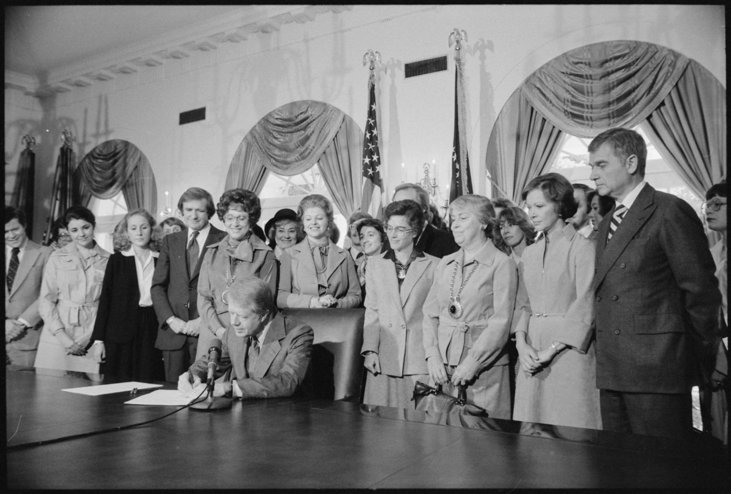
Carter signing the extension for the ratification of the Equal Rights Amendment (ERA).

Slide 30
The Gay Liberation Movement
The birth of the gay liberation movement was at the Stonewall Inn.
  On the night of June, 1969, a squad of New York police men raided the Stonewall Inn, a Greenwich Village bar frequented by “drag queens” and lesbians. As these patrons were herded into vans, a crowd of homosexual onlookers jeered and taunted the police. A riot broke out, and the next night, more than four hundred police officers battled two thousand gay demonstrators through Greenwich Village streets.
In the 1980s, the AIDS epidemic forced the gay liberation movement onto the defensive.
  This due to a rumor that AIDS was a “gay disease” and male homosexuals faced new condemnation while trying to care for the growing amount of victims to this disease within their ranks.
Bill Clinton promised to allow homosexuals into the military, but was convinced the acceptance of gays and lesbians would destroy morale and seriously weaken the armed forces. He settled for a policy of “Don’t ask, don’t tell”. Homosexuals were allowed in the military as long as they didn’t disclose their sexuality and refrained from homosexual conduct.

Slide 31
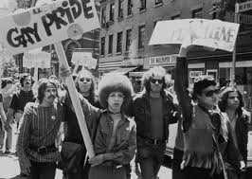
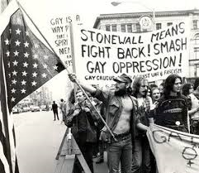
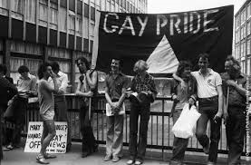
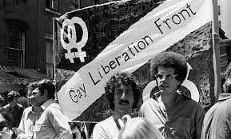
Images of Gay Liberation Movement riots of Stonewall Inn and throughout 1970s

Slide 32
The AIDS Epidemic
AIDS –acquired immune-deficiency syndrome, a disease of the immune system transmitted through blood, especially by sexual contact or contaminated needles
  HIV (human immunodeficiency virus)originated in Central Africa and later spread to America, often leads to AIDS
  the outbreak of AIDS occurred in the early 1980s, taking most Americans by surprise. Doctors had a hard time understanding the nature of the disease due to limited knowledge
  Initially AIDS was believed to only affect gay men; however, the disease appeared among intravenous drug users, who shared the same needles, hemophiliacs, and among people who received frequent blood transfusions
  The spread of a contaminated national blood supply and the possibility of the spread of the disease to heterosexuals terrified Middle Class Americans
    The death of Rock Hudson, a movie star, from AIDS further intensified the public’s growing fear

Slide 33
The AIDS Epidemic
AIDS
  The Reagan administration proved to be slow and halting in its approach to AIDs
    Lack of sympathy for the gay community and a need to reduce the deficit were two factors that inhibited an increase in health spending
  Whatever money was available in the fight against AIDS went directly to research instead of educational measures
  Surgeon General C. Everett Koop, in 1986, initiated proposals for sex education, the use of condoms, and confidential blood testing
  As the Reagan administration dallied, the growing number of cases and death greatly increased
    November 1983, 2803 cases, 1416 deaths

Slide 34
The AIDS Epidemic
AIDS
  Reagan appointed Admiral James Watkins, former chief of naval operations, to study the AIDS epidemic
  Watkins criticized the administration for its lack of action against AIDS and proposed a new effort that included antidiscrimination legislation and explicit prevention education
  Despite these efforts, the epidemic continued to claim many lives
    1987, 50,000 cases
    1989, 100,000 cases
    End of 1991, 200,000 cases
    Mid-1996, 500,000 cases
      AIDS became the leading cause of death for Americans between the ages of 25 to 44

Slide 35
The AIDS Epidemic
AIDS
  Mid-1990s, death rates of AIDS began to decline due to heavier spending on research on treatment and prevention and the new drug combinations

Slide 36
The Ford Administration
Ford Administration
  Nixon had appointed Gerald R. Ford, the first president who had not been elected to national office, to the vice presidency, following the resignation of Spiro Agnew
  Ford was an amiable and unpretentious Michigan congressman, who had risen as the House minority leader, ready to restore public confidence in the presidency after replacing Nixon
  However, on September 8, 1974, Ford granted Nixon a full and unconditional pardon for all federal crimes he may have committed
    Critics charged Ford as secretly bargaining with Nixon ; others pointed out how unjust it was for Nixon to walk out free from all charges

Slide 37
The Ford Administration
Ford Administration
  To make matters worse, Ford announced how the CIA had been involved in plots to assassinate foreign leaders
  CIA was charged for having been involved in no less than 8 separate attempts to kill Fidel Castro
  Frank Church, chairman of the Senate committee, tried to put all the blame on the CIA to prevent the tarnishing of Kennedy’s and Johnson’s reputations

Slide 38
The Ford Administration
Ford Administration
  Late 1975, Ford appointed George H.W. Bush as CIA’s new director to revitalize the agency’s role in shaping national security and to reform
  Ford also issued an executive order outlawing further assassinations as an instrument of American foreign policy

Slide 39
The Ford Administration
Ford Administration
  Ford proved to be more conservative than Nixon
    Opposed Democratic measures, including,
      Federal aid to education
      Control over strip mining
    Vetoed 39 bills

Slide 40
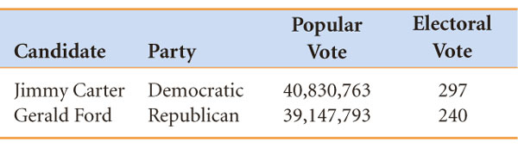
Carter and American Malaise
Carter and American Malaise
  Election of 1976
    James Earl Carter, former Georgia governor, ran as an outsider, portraying himself as a Southerner
    Gerald Ford
    Carter won the election, defeating Gerald Ford

Slide 41
Carter and American Malaise
Carter Administration
  Carter lacked a sense of direction, calling himself a populist
  Carter nonetheless strove for a balanced budget but was forced to accept mounting deficits
  Federal agencies fought to save environment, but only managed to anger industry
  Joseph Califano, Secretary of Health, Education, and Welfare (HEW), failed to carry out long overdue reforms
    Carter’s unwillingness to take political risks led to revamping the overburdened social security system, like reducing benefits and raising the retirement age. This blocked Califano’s efforts to create a manageable national health insurance plan

Slide 42
Carter and American Malaise
Carter Administration
  Having been informed that he was losing the public’s confidence, Carter blamed the American people for creating “a crisis of confidence…that strikes at the very heart and soul and spirit of our national will.”
  After his “national malaise” speech, Carter requested the resignation of Califano and the Secretary of Treasury

Slide 43
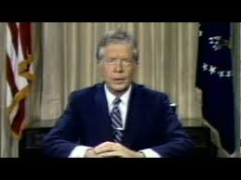
“Crisis of Confidence” Speech
https://www.youtube.com/watch?v=1IlRVy7oZ58

Slide 44
Troubles Ahead
In the aftermath of the Vietnam War and the country’s troubling economic state, most Americans wanted little do with the world; however, the Third World groups didn’t get the message of détente
Central America
  Mid 1979, dictator Anastasio Somoza capitulated to the Sandinista forces in Nicaragua; the new regime moved steadily to the left, developing close relations with Castro’s Cuba
  In El Salvador, a growing leftist insurgency against a repressive regime placed the United States in an awkward position
  Carter eventually tried to find a workable alternative, utilizing American economic aid to encourage military junta in El Salvidor
  In 1981, Carter authorized large scale military assistance to the government for its war against insurgents

Slide 45
Troubles Ahead
Middle East
  Carter invited Egyptian president, Anwar Sadat, and Israeli prime minister, Menachem Begin, to negotiate a peace treaty under at Camp David for thirteen days, finally emerging with Camp David accords
    Camp David Accords, paved the way for a 1979 treaty between these principal antagonists, providing for the gradual return of the Sinai to Egypt

Slide 46
Troubles Ahead
Middle East
  The outbreak of the Iranian revolution caused the offset of progress in the Middle East
    The shah, with whom the United States depended upon for defense of the Persian Gulf, was forced to flee the country after the exiled Ayatollah Ruholla Khomeini led a funamentalist Muslim revolt against the shah

Slide 47
Troubles Ahead
Middle East
  In October of 1979, Carter allowed the shah to enter the United States for medical treatment. As retaliation, Irate mobs denounced the United States
  November 4, in Iran militants seized U.S. embassy in Tehran, taking 53 hostages
    The Iranian hostage crisis revealed that American power had declined in the 1970s
  April 1980, the president authorized a rescue operation but the mission ended in failure when several helicopters broke down and an accident cost the lives of eight crewmen

Slide 48
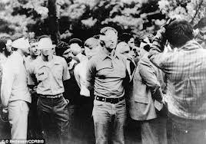
The Iranian Hostage Crisis dragged on for the rest of Carter’s administration; the hostages were not released until January 1981

Slide 49
The Collapse of Détente
Congress refused to relax trade restrictions on the Soviet Union; the Kremlin’s repression of growing dissident movement and its harsh policy restricting the emigration of Soviet Jews caused many Americans to doubt the wisdom of seeking accommodation with the Soviet Union

Slide 50
The Collapse of Détente
Carter’s emphasis on human rights led Russians to believe Carter’s concern to be a direct repudiation of détente
  Carter withheld aid from authoriatarian governments in Chile and Argentina, and harsh regiments in South Korea and the Philippines; however, Carter received Soviet exiles in the White House
Secretary of State, Cyrus Vance, continued to concentrate on the main pillar of détente, the Strategic Arms Limitation Talks (SALT)
  In 1974, President Ford had met with Brezhnev in Vladivostok and reached an agreement on the outline of SALT II, the chief provision being for a ceiling f twenty-four hundred nuclear launchers by each side
  March 1977, Vance went to Moscow to propose a reduction in this level; the Soviets rejected the proposal

Slide 51
The Collapse of Détente
Zbigniew Brzezinski, Carter’s natinal security adviser, worked to reverse the policy of détente
  He favored confrontation with the Kremlin
  Prevailing on the president, Brzezinski advocated adoption of a new MX missile to replace the existing Minuteman ICBMs
  He also successfully persuaded the president to use China to outmaneuver the Soviets
    On January 1, 1979, the United States and China exchanged ambassadors; the new relationship between the United States and China presented the Soviet Union with the problem of a link between its two most powerful enemies

Slide 52
The Collapse of Détente
In December 1979, the Soviet Union invaded Afghanistan, appearing to many as the beginning of a Soviet thrust toward the Indian Ocean and the Persian Gulf
Carter responded to this aggression by declaring a “Carter Doctrine” that threatened armed opposition to any further Soviet advance toward the Gulf
  Carter banned the sale of high technology to Russia, embargoed the export of grain, resumed draft registration, and even boycotted the 1980 Moscow Olympics

Slide 53
The Collapse of Detente
The Soviet action and the United States’ reaction doomed détente
  Carter, aware he could not achieve getting two-thirds of the votes in the Senate, Carter withdrew the SALT II treaty

Slide 54
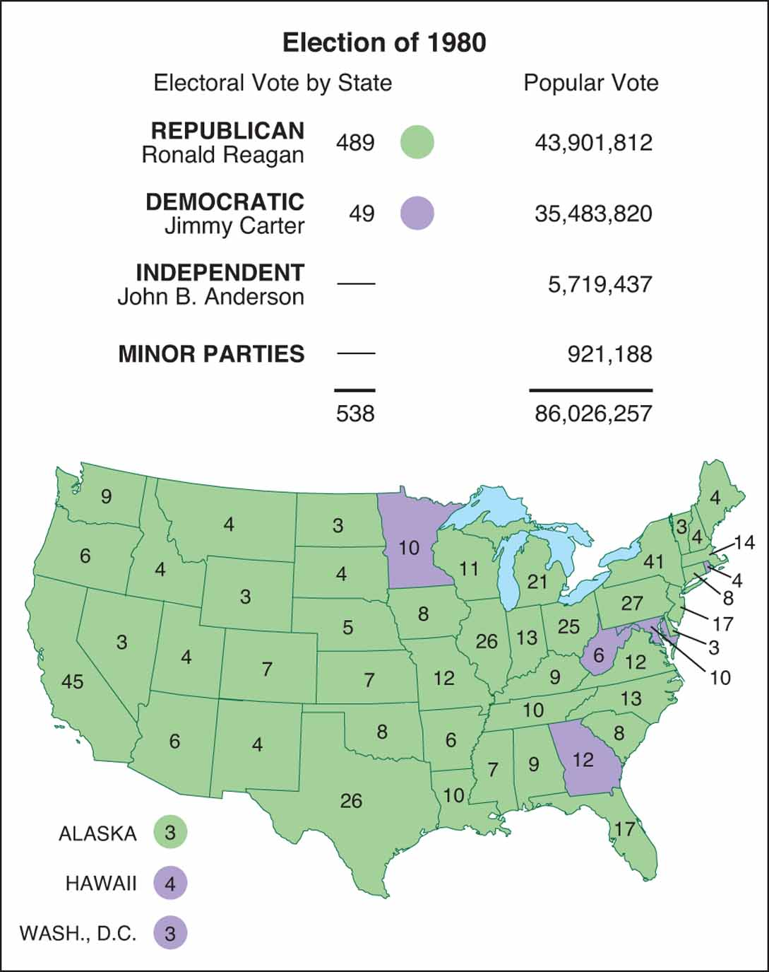
The Election of 1980

Slide 55
The Election of 1980
Ronald Reagan was met with trouble in regards to inflation, touched off by the second oil shock of the 1970s
  Federal Reserve Board’s effort to tighten the money supply had led to a recession; early in 1980, the combined rate of inflation and unemployment hit 28 percent, staying above 20 percent throughout the year
  The Soviet invasion of Afghanistan and the prolonged hostage crisis in Iran were traits of the previous administration
Reagan, running mate George H.W. Bush, scored heavily among Democratic blue collar groups, blaming Carter for inflation and allowing the Soviets to outstrip the United States militarily, also using the Watergate trauma for his campaign
Carter accused Reagan of being two reckless, portraying Reagan as a warmonger
Anderson appealed to voters disenchanted by Carter but not yet ready for Reagan

Slide 56
The Election of 1980
Election of 1980
  Reagan carried 49 states, gained 51% of popular vote
  Carter carried 6 states, gained 41% of popular vote
  Anderson failed to carry a single state; however hurt Jimmy Carter’s reelection chances
  Republican gains proved to be more surprising
    Since 1954, the GOP gained control of the Senate 53 to 46, the party picking 33 seats in the House
    The Democratic coalition was falling apart

Slide 57
Cutting Taxes and Spending
When Ronald Reagan took office in January 1981, he was faced with “the worst economic mess since the Great Depression”
He embraced the concept of Supply-Side Economics
  Supply-Side Economics, advocates of this concept believed that tax cuts would stimulate the economy by giving individuals a greater incentive to earn more money
Reagan slashed $41 billion by cutting from other social services, such as food stamps and by reducing public service jobs, student loans, and support for urban mass transit
Reagan appeared before the Congress, only weeks after an attempt on his life, winning 253 to 176 in the House, and 78 to 20 in the Senate for his budget
Initially advocating for annual cuts of 10% in personal income taxes for three consecutive years, Reagan compromised to cut taxes by 5% in the first year but insisted on the full 10% reduction for the second and third years
Reagan demonstrated his ability to wield presidential power

Slide 58
Unleashing the Private Sector
Reagan made efforts to restrict government activity and reduce federal regulation of the economy, but had mixed success.
He used his goal of “deregulation” to appoint people into his cabinet with the same beliefs.
The decision of behalf of Secretary of the Interior, James Watt were much debated. He opened up federal land to coal and timber production and stopped the growth of national parkland.
Watt was eventually forced to resign.

Slide 59
Unleashing Private Sector
Drew Lewis was the most effective cabinet member in Reagan’s first two years.
  He helped relieve American automobile industry of many of the regulations to reduce air pollution and increase passenger safety.
  He also helped behind-the-scenes with negotiations that had led Japan to restrict their automobile exports.
The Reagan Administration ended a strike by air traffic controllers in 1981.
  Reagan denounced PATCO, who were in charge of the strike, fired them, and decertified the union. Lewis was ordered to hire and train new air traffic controllers.

Slide 60
Unleashing Private Sector
The Reagan administration viewed the entitlement programs as primary causes of the budget deficit but weren’t successful at cutting back.
  The greatest offender of the budget deficit was Social Security. Reagan appointed a bipartisan commission to find ways to protect the systems endangered trust fund.
  They gradually rose the retirement age, delayed the cost-of-living increases for six months, and lastly, they taxed the pensions of wealthy elderly.

Slide 61
Unleashing Private Sector
The Reagan Administration’s record in dealing with women’s civil rights and concerns was not respectable.
Feminists were pleased when Sandra Day O’Connor was appointed to the Supreme Court by Reagan.
The appointment of Sandra Day O’Connor had fulfilled one of Reagan’s campaign pledges and also was a symbolic gesture toward women.
In Reagan’s first 72 nominees to the federal judiciary, only 3 were women and only one out of 69 men was African American.

Slide 62
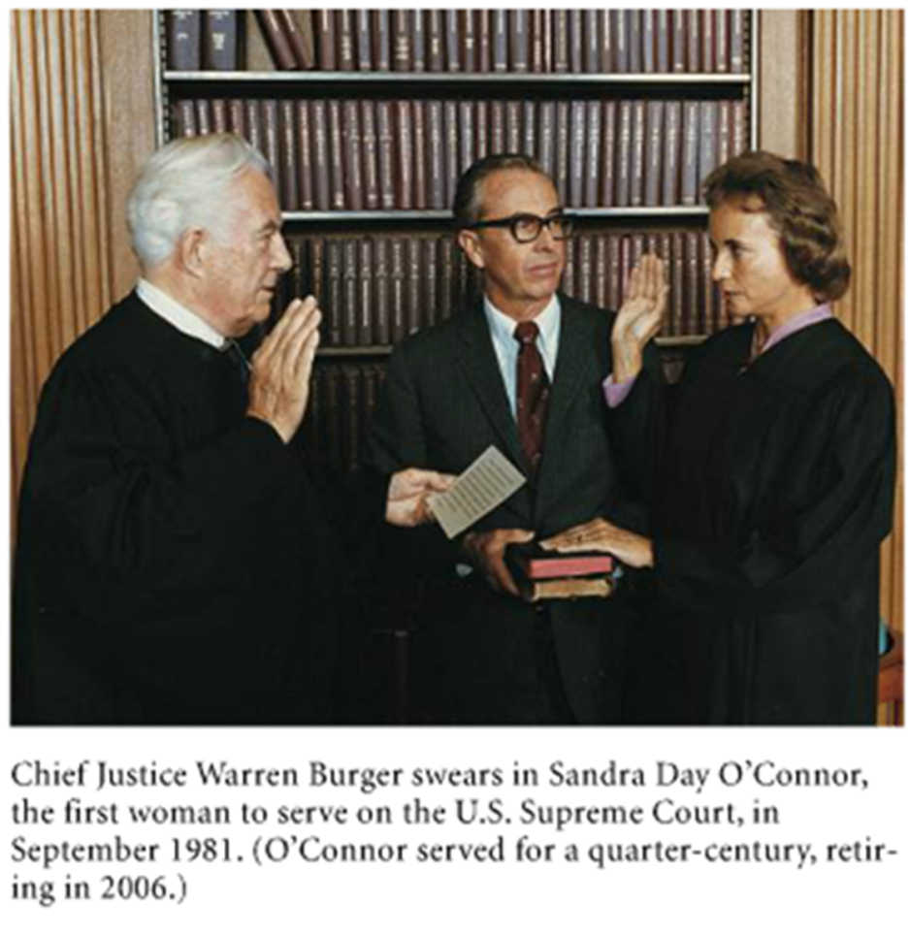
Sandra Day O’Connor’s Appointment to the Supreme Court

Slide 63
Challenging the "Evil Empire"
Major military expansion under Reagan
Reagan: The Soviet Union was the "focus of evil in the modern world"
  The central tenet of Reagan’s approach to foreign policy was the belief that the Soviet Union was a deadly enemy that threatened the U.S.
    During Reagan’s visit to Berlin in 1982, his meeting with German leaders involved a concern over the Berlin Wall and the division of Germany.
Reagan escalates arms race
  Deployment of cruise missiles in Europe
  Development of Strategic Defense Initiative
    SDI is an antimissile system based on the use of lasers and particle beams to destroy incoming missiles in outer space.

Slide 64
Confrontation in Central America
Lack of moderate, middle-class regimes led U.S. to support oppressive right-wing dictatorships
This put U.S. at odds with reform movements, which the U.S. saw as linked to Communism
Reagan reversed Carter’s support for Sandinistas, driving them to Soviets
Reagan began converting support for Contras after Congress rejects overt support
In 1979, the Sandinista Coalition succeeded in overthrowing the repressive Somoza regime in Nicaragua.

Slide 65
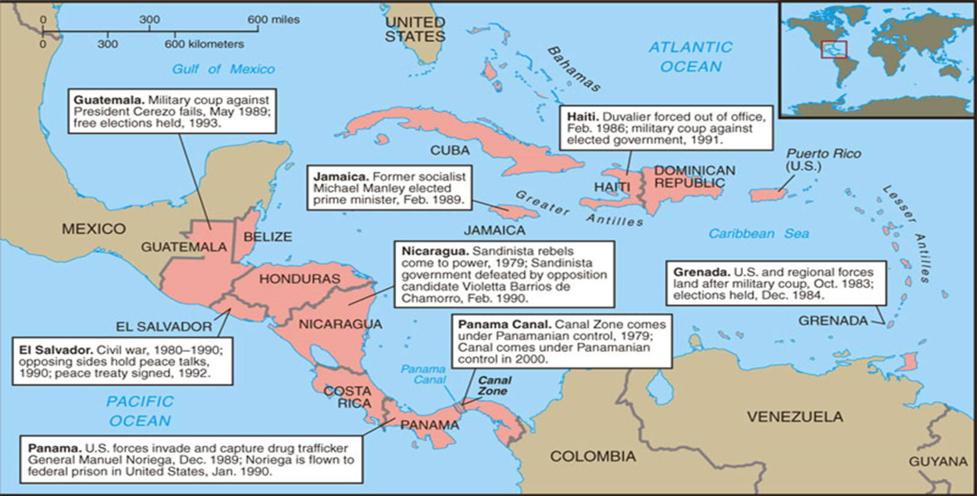
Trouble Spots in Central America and the Caribbean

Slide 66
More trouble in the
Middle East
1982: With U.S. encouragement, Israel invaded Lebanon
International response
  U.S., France send troops to maintain order
  Palestine Liberation Organization evacuated to Tunisia
1984: 200 U.S. Marines killed in terrorist bombing
U.S. evacuation of Lebanon

Slide 67
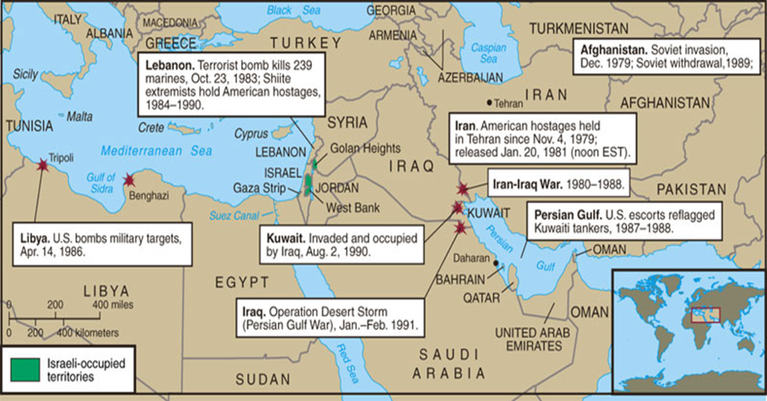
Trouble Spots in the
Middle East

Slide 68
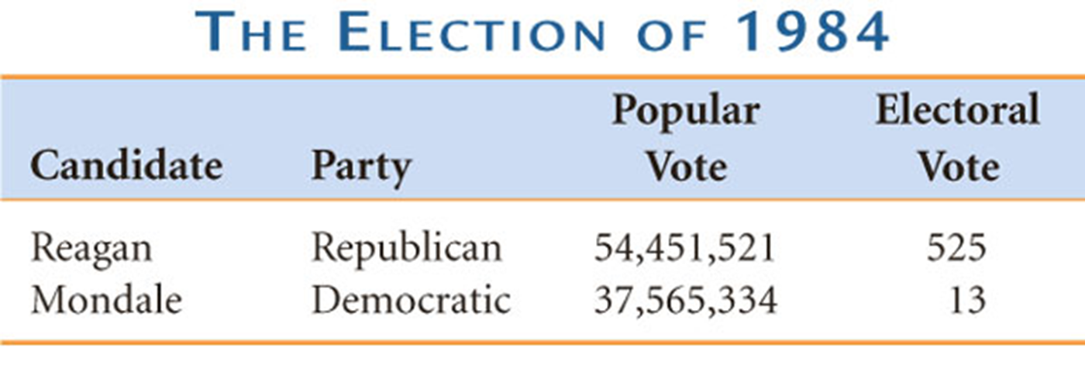
The Election of 1984
Geraldine Ferraro became the first women ever nominated for the vice presidency by a major party in 1984.

Slide 69
Trading Arms for Hostages
The Reagan administration’s policies in the Middle East and Central America reached a tragic union in the Iran-Contra affair.
Iranian-backed Lebanese militants seized 6 Americans hostage
Advanced weapons sold to Iran for influence in freeing American hostages
Oliver North’s plan: Iran-Contra scandal
  Profit from Iran arms sales to Contras
  Funding clearly violates Boland Amendment
  Reagan escaped impeachment, North and others were jailed

Slide 70
Reagan the Peacemaker
1985: Mikhail Gorbachev assumed power in Russia.
  Soviet Leader Mikhail Gorbachev’s new policies included perestroika and glasnost.
1985–1988: Reagan-Gorbachev summits
  1987: Destroyed intermediate range missiles
  1988: Afghanistan evacuated
Foreign policy triumphs with Soviets, offsets Iran-Contra scandal

Slide 71
Challenging the New Deal
Reagan’s Presidency saw breakup of Democratic New Deal Coalition
New Deal premises were challenged by Reagan’s view that the private sector rather than government should be the source of remedy for America’s ills
Popular centerpieces of welfare state left intact
Small government conservatism was the wave of the future

