Slide 1
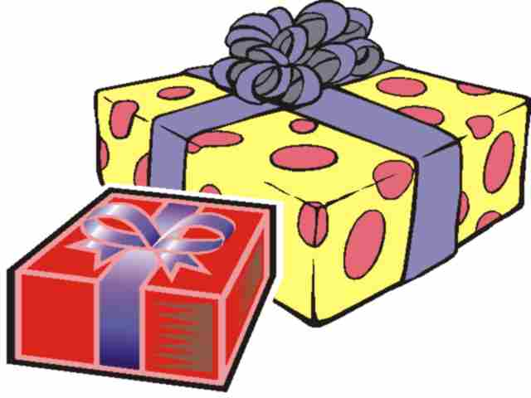
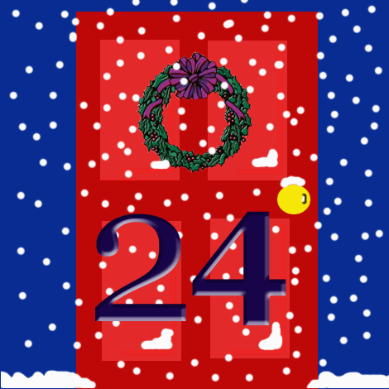
1. When are presents opened in Germany?
a. Christmas Eve
b. Christmas Day
c. Boxing Day

Slide 2
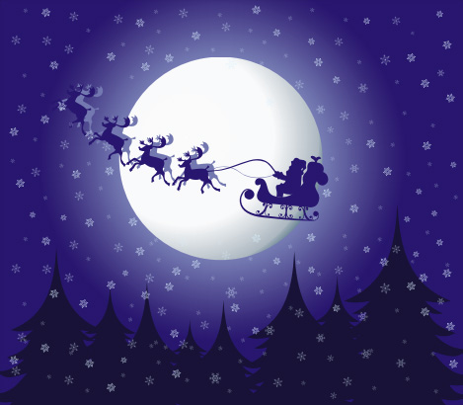
When are presents opened in Germany?
German children open their presents on Christmas Eve. They often go to Church, then have a meal with their family and then open presents.

Slide 3
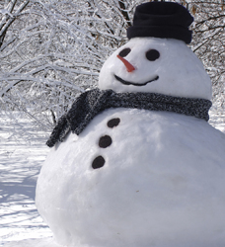
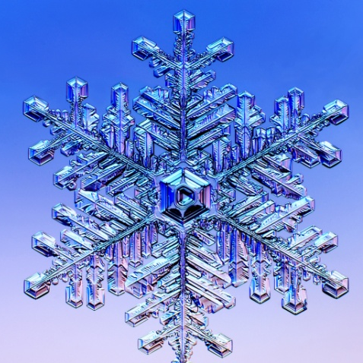
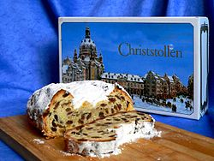
2. What is Stollen?
a. A Christmas decoration
b. A special cake
c. A Christmas drink

Slide 4
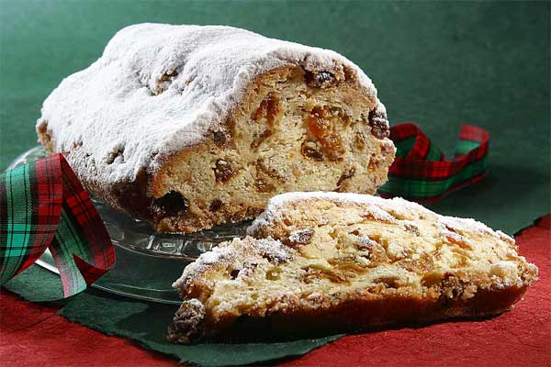
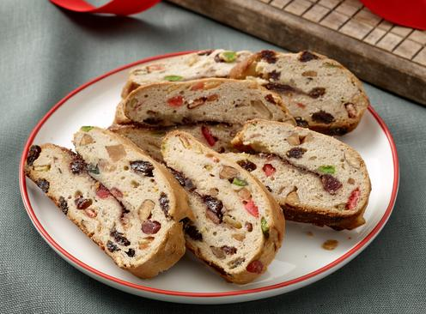
What is
Stollen?
Stollen is a special cake that is eaten at Christmas.It has lots of dried fruit in it and marzipan. It was first made in 1427.

Slide 5
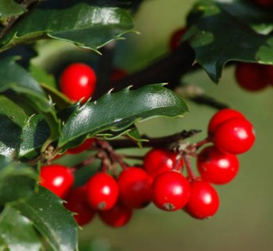
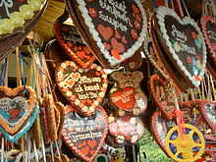
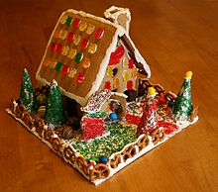
3. What are Lebkuchen?
a. A type of gingerbread
b. A Christmas carol
c. A Christmas drink

Slide 6
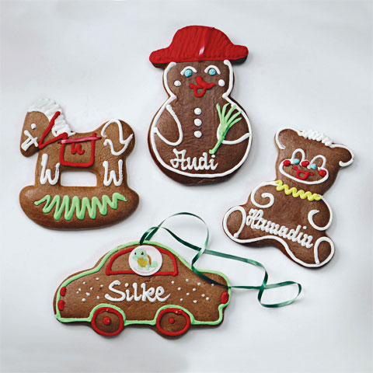
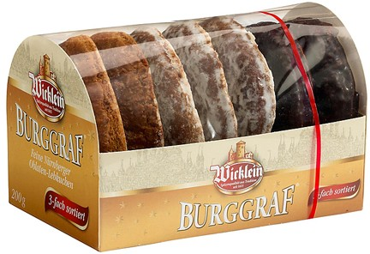
What are
Lebkuchen?
Lebkuchen are a type of gingerbread, but with some extra spices in. They are sold as biscuits, hearts and houses.

Slide 7
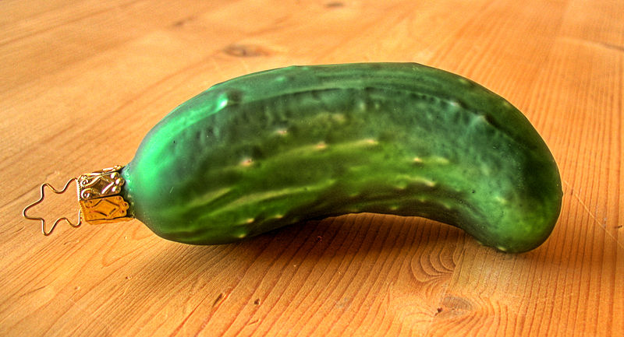
5. Which food item can you find on some German Christmas Trees?
a. A lettuce
b. A tomato
c. A gherkin

Slide 8
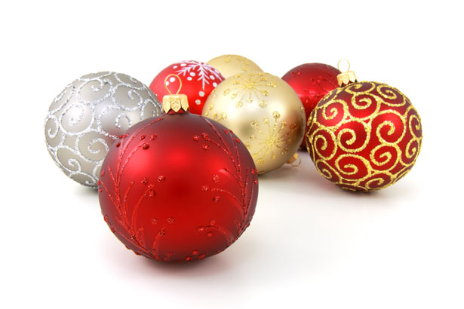
Which food item can you often find on German Christmas Trees?
This is also a tradition in America. They say that it comes from Germany, but it may actually be the other way around. If you manage to find the gherkin on the tree, you can open your presents first.

Slide 9
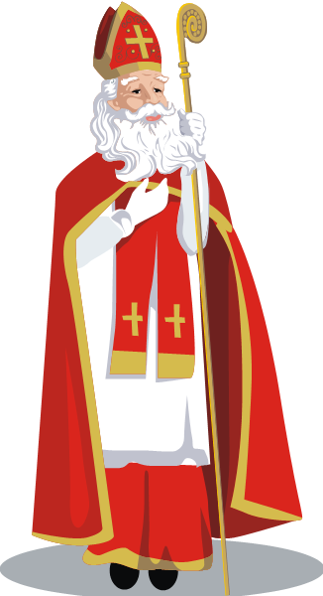
6. When is Nikolaustag?
a. 1st December
b. 6th December
c. 6th January

Slide 10
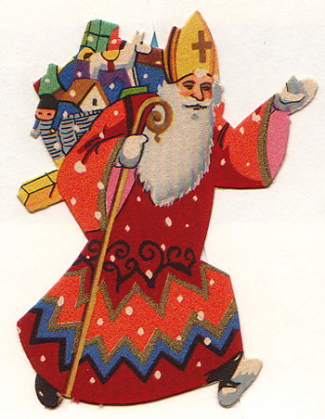
When is Nikolaustag?
Nikolaustag is called St. Nicholas’ Day in England. It is on the 6th December. Children leave their shoes out the night before and when they wake up, St. Nicholas has filled them with sweets and gifts.

Slide 11
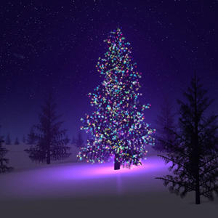
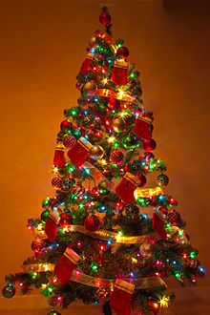
7. What day do most German families put up their Christmas tree?
a. 1st December
b. 6th December
c. 24th December

Slide 12
Who is Krampus?
A. Santa’s elf
B. A Christmas Devil
C. A Christmas Angel

Slide 13
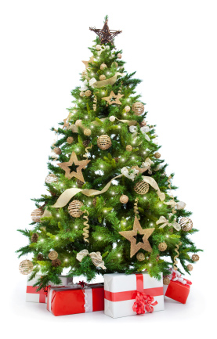
What day do most German families put up their Christmas tree?
Most families decorate their trees on Christmas Eve. They then put all of the presents under it. Some families even cut their own tree down from woods near where they live.

Slide 14
7. What day do most German families put up their Christmas tree?
a. 1st December
b. 6th December
c. 24th December

Slide 15
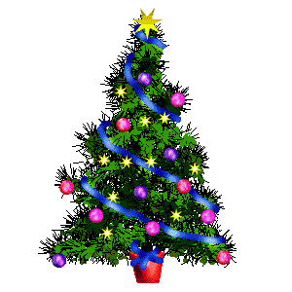
8. Which Christmas traditions originally started in Germany?
The Christmas tree comes from Germany. Children are not involved in decorating the tree. It is believed that the tree has some mysterious spell for all young eyes that rest on it before Christmas Eve, so the parents decorate the tree in secret.

Slide 16
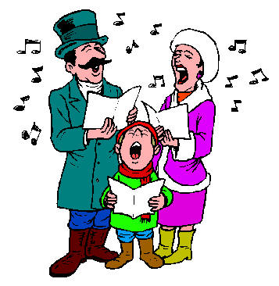
9. Which country was “Silent Night” originally written in?
a. Switzerland
b. Germany
c. Austria

Slide 17
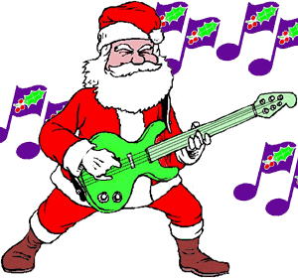
9. Which country was “Silent Night” originally written in?
"Silent Night" or “Stille Nacht“ was composed in Austria in 1818. In 2011, it declared as an intangible cultural heritage by UNESCO.

Slide 18
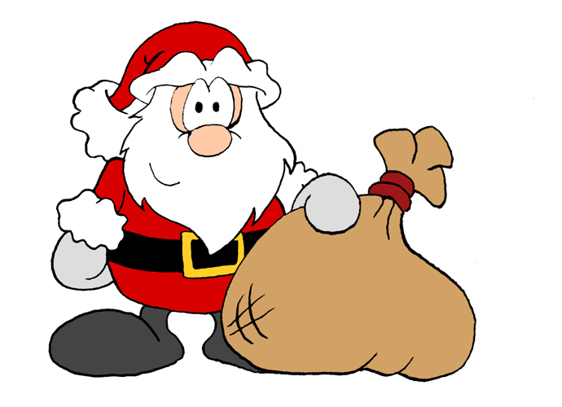
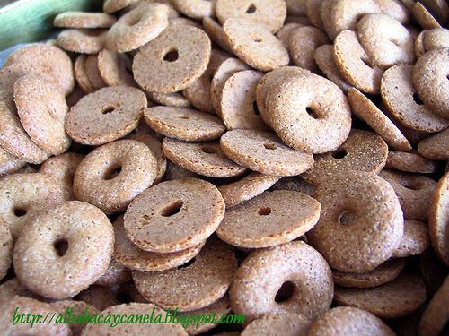
10. What are “Ringli”?
a. A Swiss Doughnut
b. A German Song
c. An Austrian Instrument

Slide 19
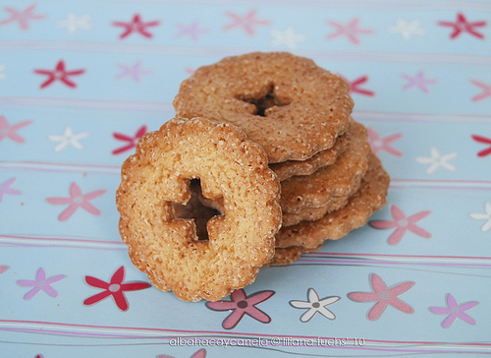
10. What are “Ringli”?
“Ringli” are a type of doughnut or biscuit that are eaten in Switzerland on Christmas Eve before opening presents. They are normally eaten with Hot Chocolate.

Slide 20
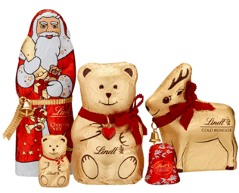
11. Who is Krampus?
a. A Christmas Angel
b. Santa’s Elf
c. A Christmas Devil

Slide 21
11. Who is Krampus?
a. A Christmas Angel
b. Santa’s Elf
c. A Christmas Devil

Slide 22
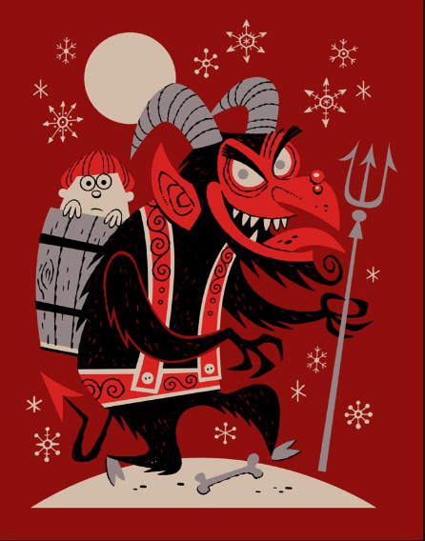
Krampus is a folklore figure who scares children into being nice (instead of naughty).

