Slide 1
Food Chain Of The Rainforest
By Joey P. and Jake B

Slide 2
Main Energy Source
Sunlight is the main energy source of the food chain.

Slide 3
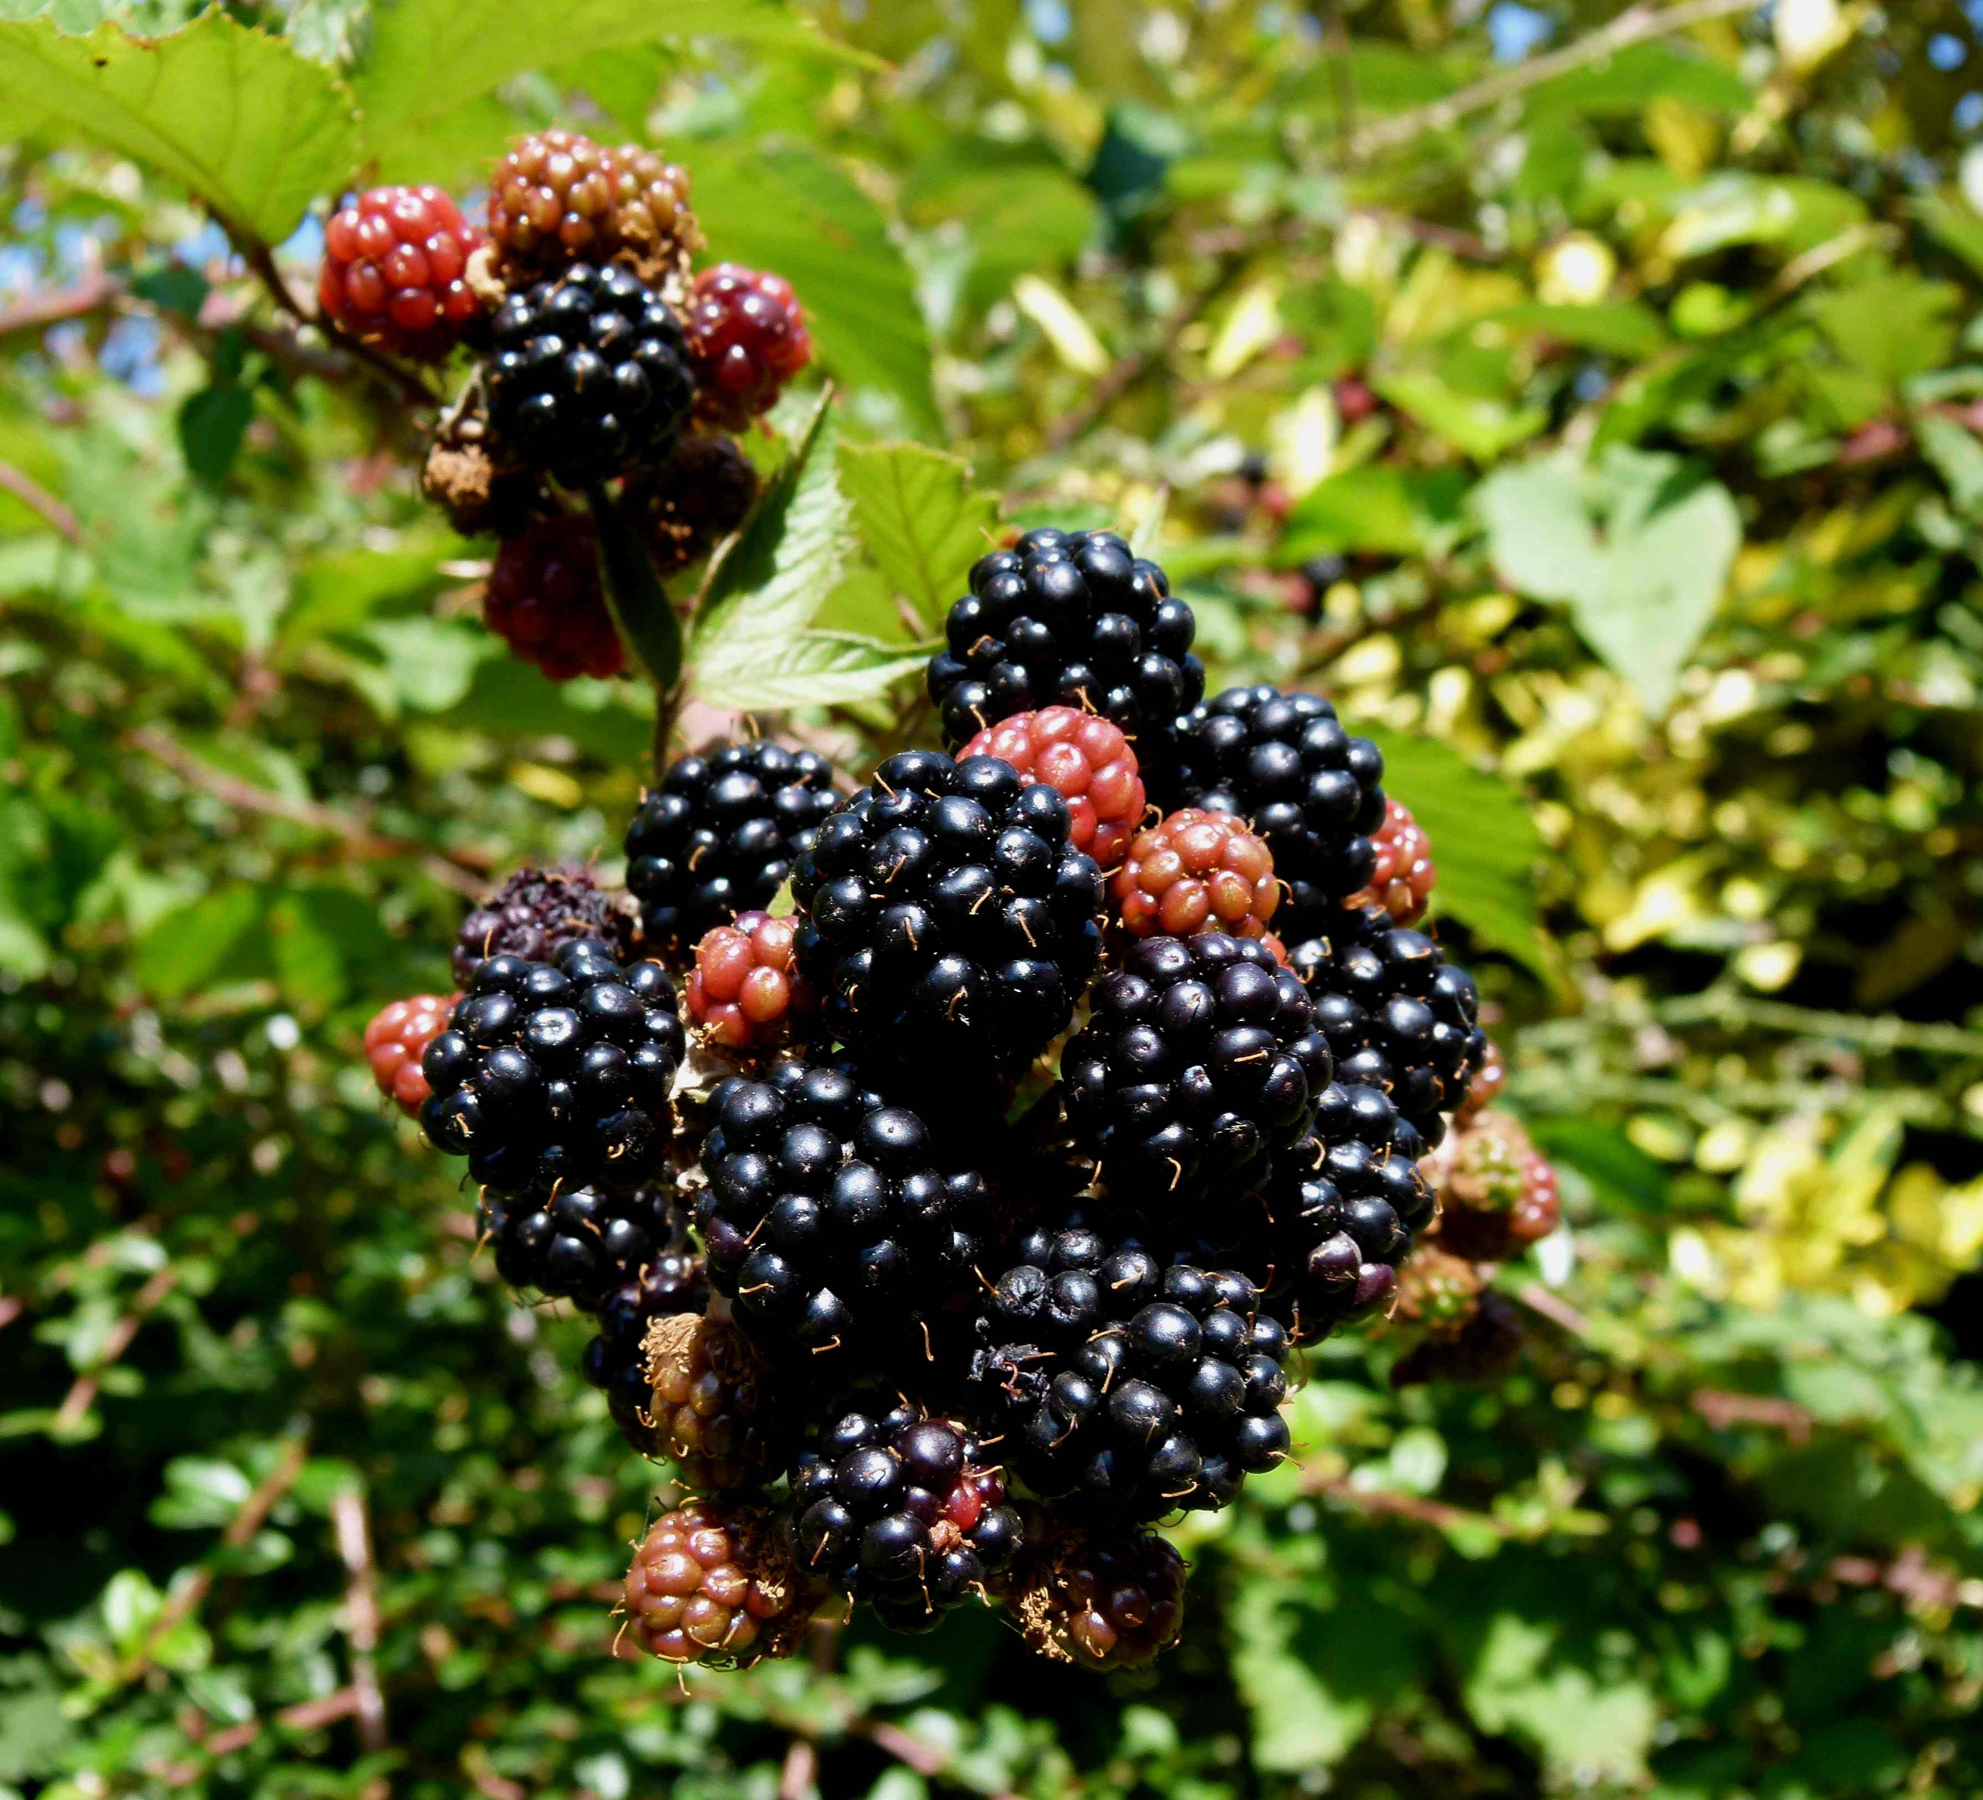
Producer
Blackberry plants get energy from the sunlight.

Slide 4
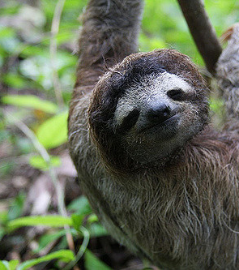
Consumer Of The Blackberry plant
Three toed sloths eat the blackberries

Slide 5
Consumer of the three toed sloth
The jaguar eats the three toed sloth.

Slide 6
How All Of The Organisms Get Their Energy
The jaguar ate the sloth to get its energy, the sloth got its energy by eating the blackberries, and the blackberries got their energy from the sun.

