Slide 1
Friday,
December 8, 2023

Slide 4
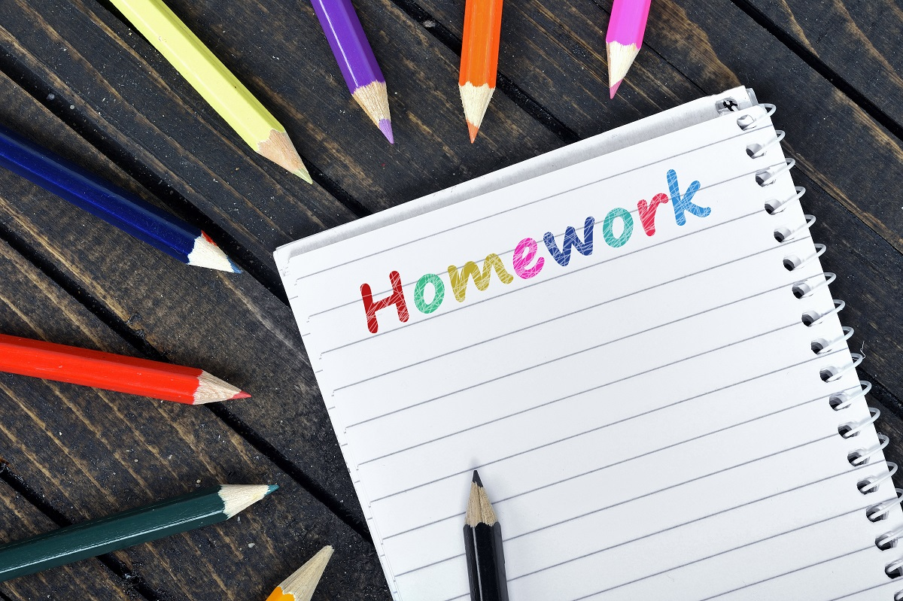
6th Grade Homework Club
Thursdays
After School

Slide 5
7th Grade Homework Club
After School:
Tuesdays – Room 220
Thursdays – Room 224

Slide 6
8th Grade Homework Club
Mondays
After School
Room 213

Slide 7
HUSTLE Drawing Dates:
December:
12/15

Slide 9
Talent Show
Auditions
Thursday, January 4
Until 4:00 PM
Please have one minute of your act ready for auditions.

Slide 10
Coding Club
Meeting
Tuesday, December 19
After School - Room 225
All are welcome to join!

Slide 11
Boys Basketball
Tryouts:
December 12

Slide 13
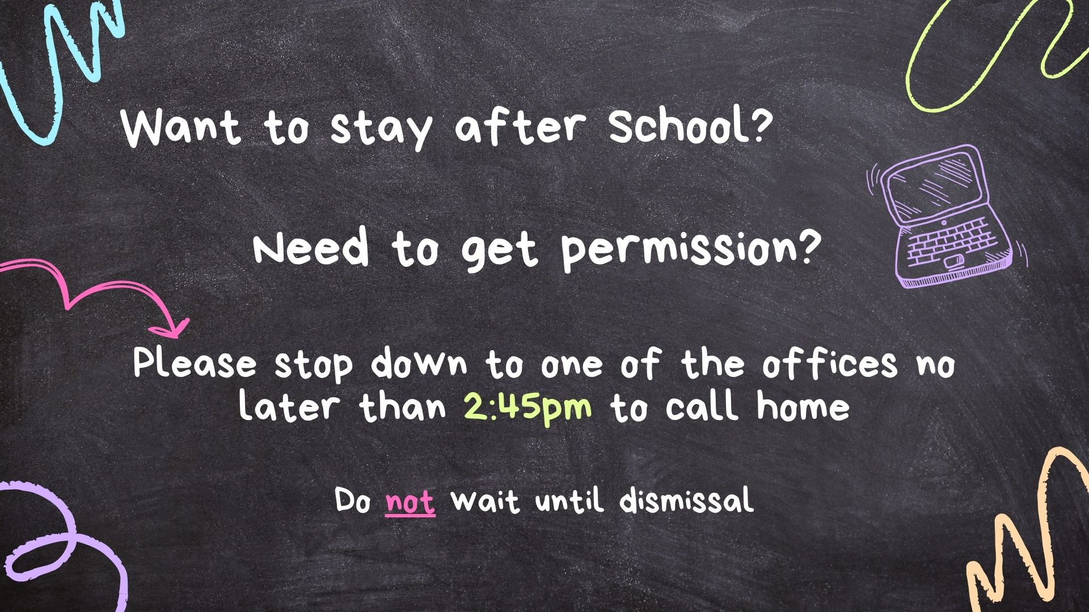

Slide 14
Today’s Morning Announcements Team:
Laylah Farrell
Connor Moffitt
Aubrianna Faust

