Slide 1
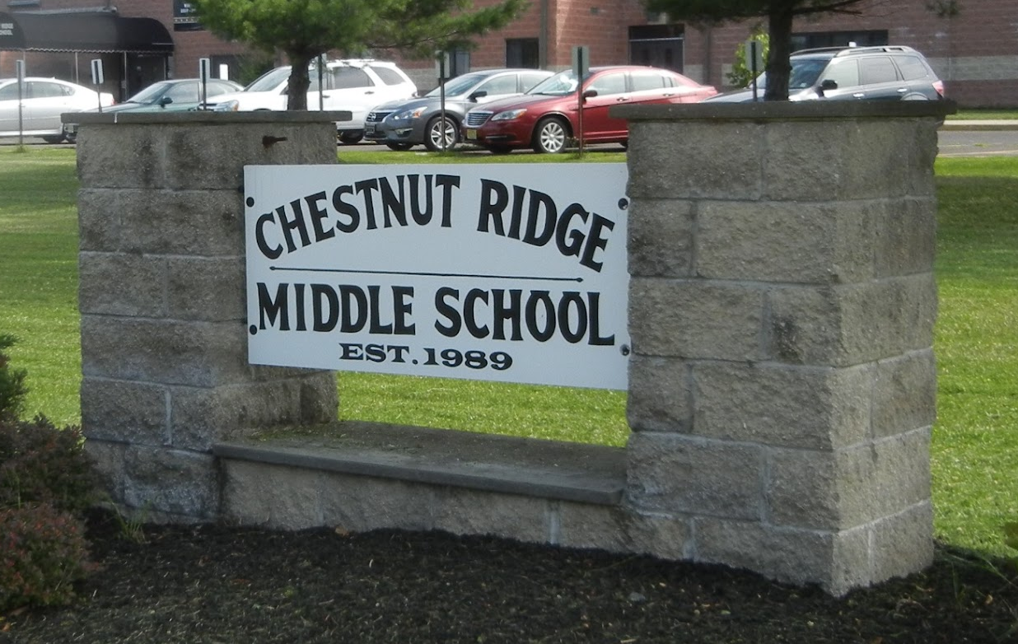
Thursday,
April 17, 2025

Slide 2


Slide 3
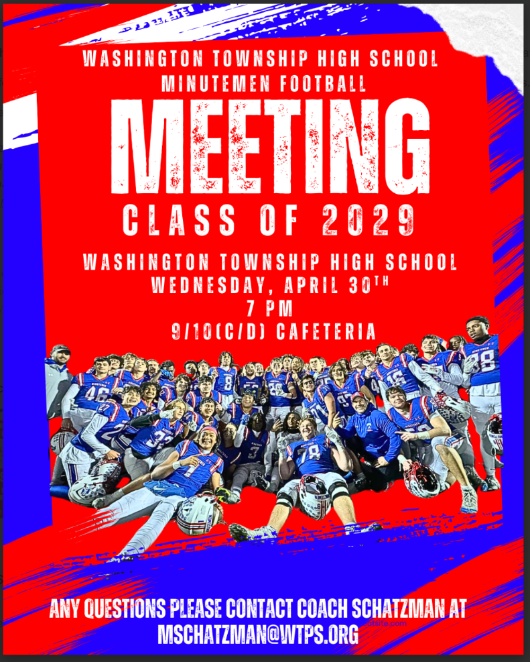

Slide 4
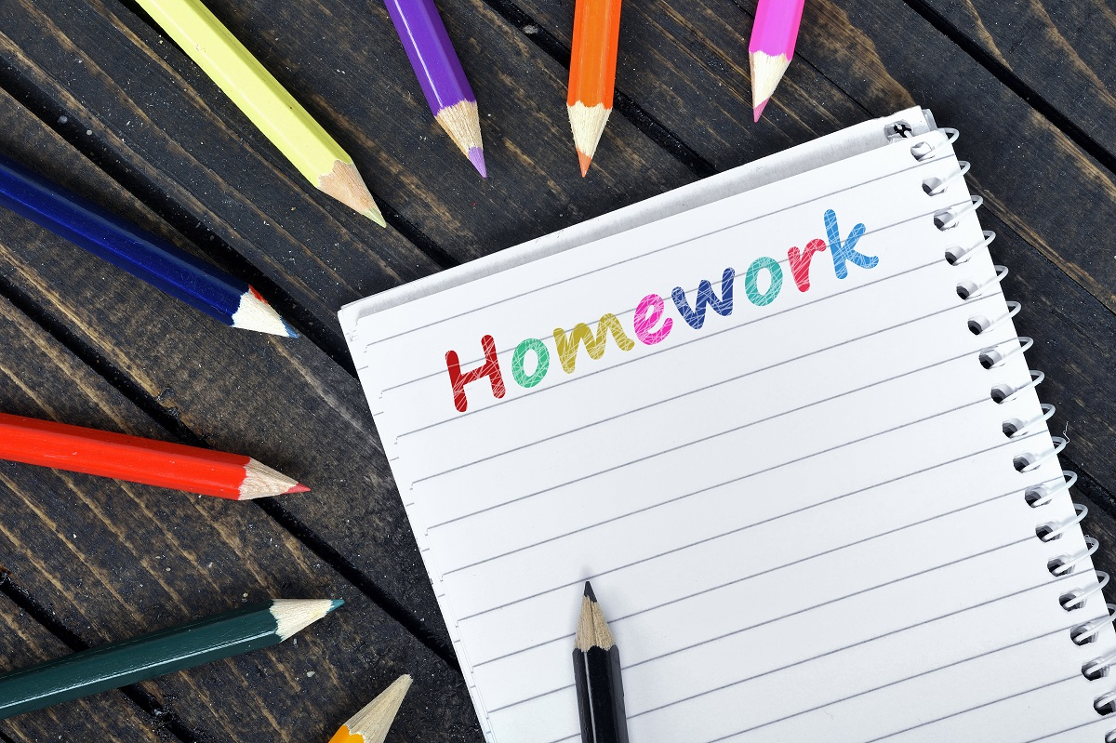
7th / 8th Grade Homework Club
Meetings:
Mondays - Room 220
Tuesdays - Room 213
Thursdays - Room 224

Slide 5

6th, 7th & 8th Grade Class Councils
Final Meeting
Thursday, May 1
Room 108

Slide 6
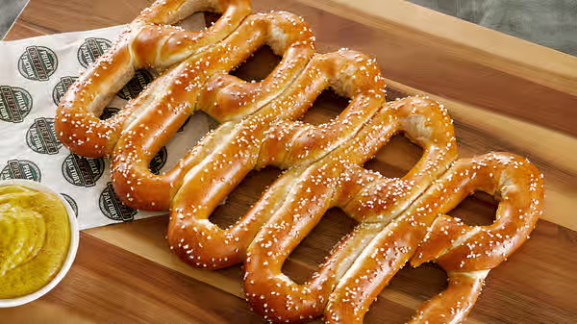
Pretzel Sale
Every Friday
On the way to your lunch period…
Room 121
$1.00
Spicy & Yellow Mustard Available

Slide 7

Today’s
Morning Announcements Team:
Victoria McKnight
Robert Montecino

