Slide 1
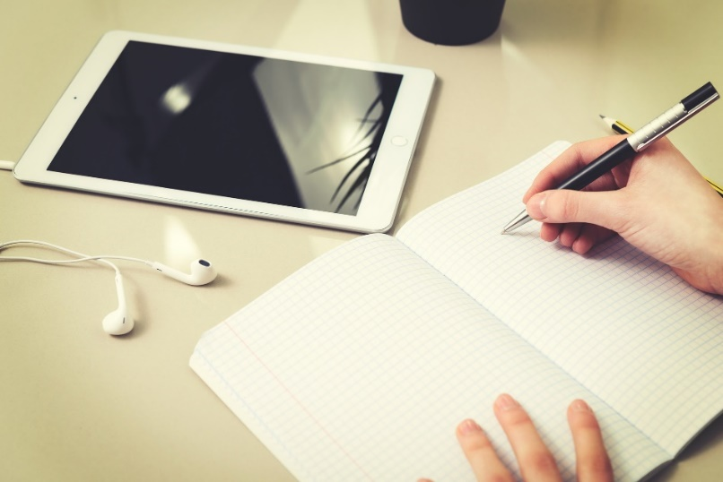
Teen Homework Haven
@ Margaret E. Heggan Free Public Library
Stuck on a school project? Having trouble with an essay? Need homework assistance?
Get help with:
Research
Heggan Library databases
Computer skills (Microsoft programs, Internet, etc.)
eBook and audiobook downloads
Job or college searches and applications
Resume or portfolio building
Available the first and third Wednesdays of the month from 2:30 -3:30pm via phone or email.
Contact the Teen Librarian for assistance at 856-589-3334, ext. 224 or email bpilling@hegganlibrary.org
Margaret E. Heggan Free Public Library
606 Delsea Drive, Sewell, NJ 08080 ● 856-589-3334 ● www.hegganlibrary.org

