Slide 1
Vocabulary Unit 5
Theme: The Incredibles

Slide 2
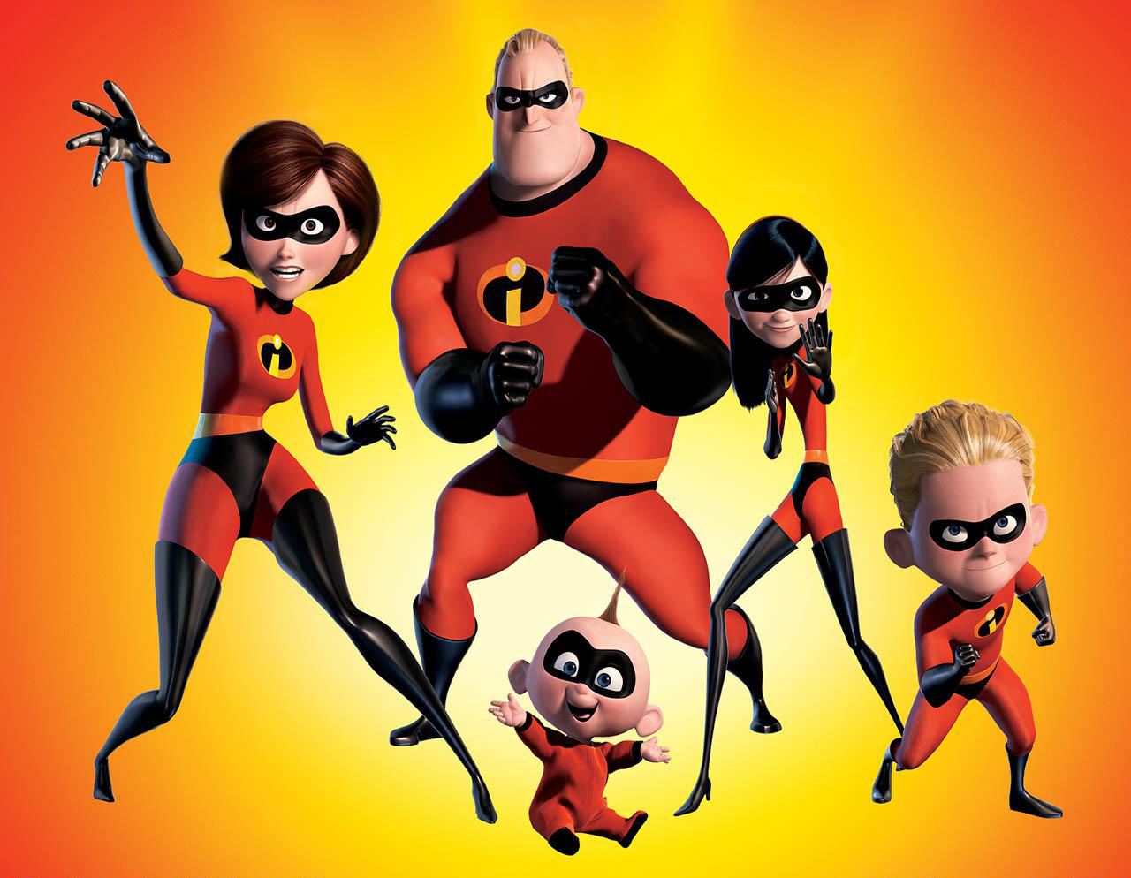
The Incredibles fight crime for altruistic reasons: they do it because they wish to help people, not receive money or favors.

Slide 3
Altruistic
Unselfish, concerned with the welfare of others

Slide 4
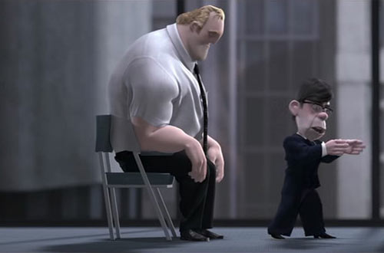
After the many lawsuits, Bob, Helen and the other “Supers” assent to living normal lives and not using their superpowers.

Slide 5
Assent
To express agreement; agreement

Slide 6
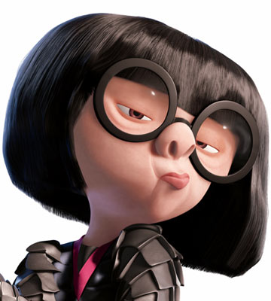
Edna Mode served as a benefactor to the Incredibles, providing them state-of-the-art, protective uniforms.

Slide 7
Benefactor
One who does good to others

Slide 8
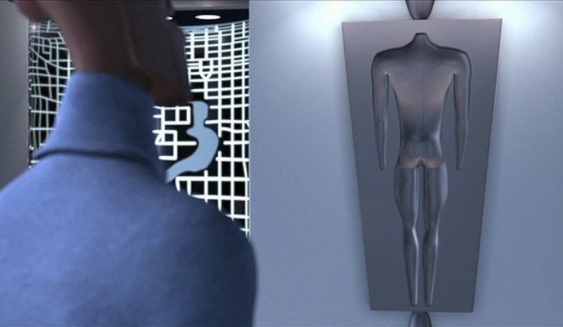
When Frozone called for his supersuit so that he could act for the “greater good,” he did it for chivalrous reasons. Too bad he insulted his wife in the process (“Greater good? I am your wife. I am the greatest good you will ever know.”)

Slide 9
Chivalrous
Marked by honor, courtesy, and courage; knightly

Slide 10
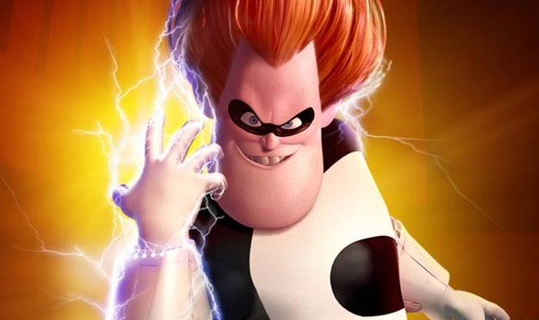
Given the damage and destruction he caused, it is unlikely anyone will grant Syndrome clemency.

Slide 11
Clemency
Mercy, humaneness; mildness; moderateness

Slide 12
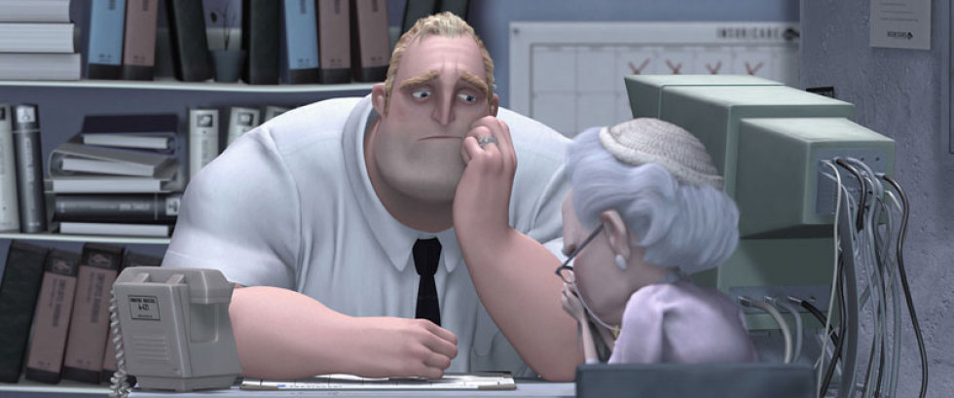
Bob finds a dearth of interest and excitement in his job at the insurance company.

Slide 13
Dearth
A lack, scarcity, or inadequate supply; a famine

Slide 14
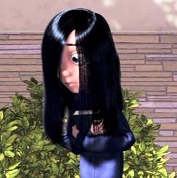
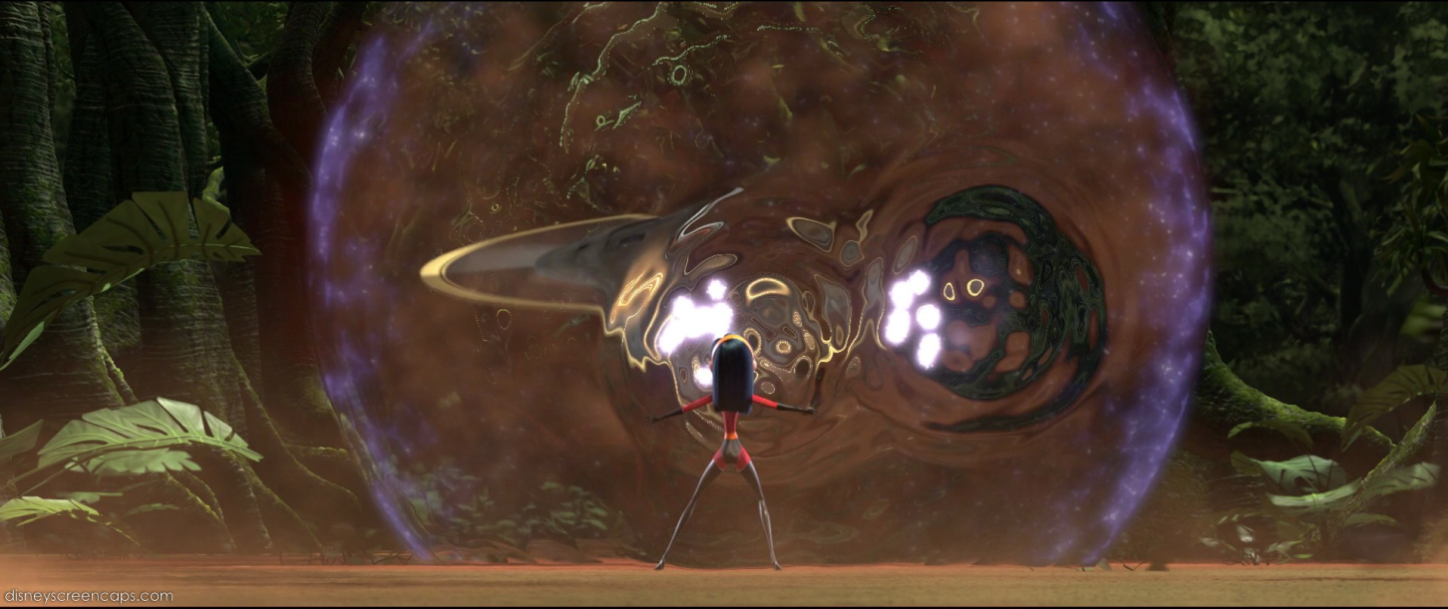
Embarrassed by her superpowers and how they make her different, Violet remains diffident until her family needs her.

Slide 15
Diffident
Shy, lacking self-confidence; modest, reserved

Slide 16
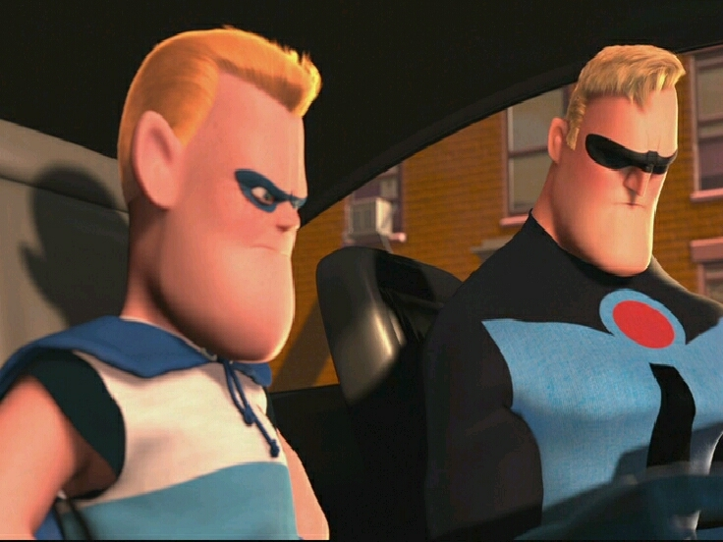
As we learn later, the discrepancy between what Buddy Pine thought happened the night he was hurt and what really happened is what made him Syndrome.

Slide 17
Discrepancy
A difference

Slide 18
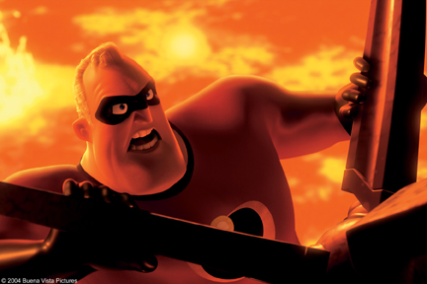
Bored with his normal life, Bob embarks on a mission to destroy the Omnidroid for the mysterious Mirage.

Slide 19
Embark
To go aboard; to make a start; to invest

Slide 20
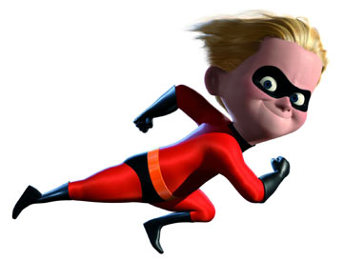
Because of his superpower, Flash finds winning a track race rather facile.

Slide 21
Facile
Easily done or attained; ready, fluent
Superficial; easily shown but not sincerely felt

Slide 22
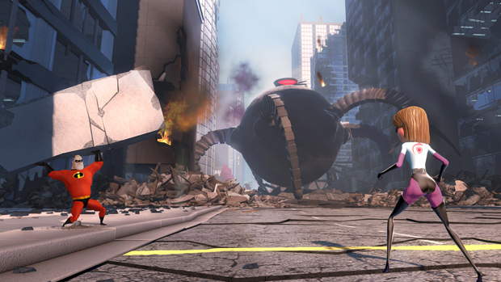
Working together, the Incredibles were able to defeat the seemingly indomitable Omnidroid.

Slide 23
Indomitable
Unconquering, refusing to yield

Slide 24
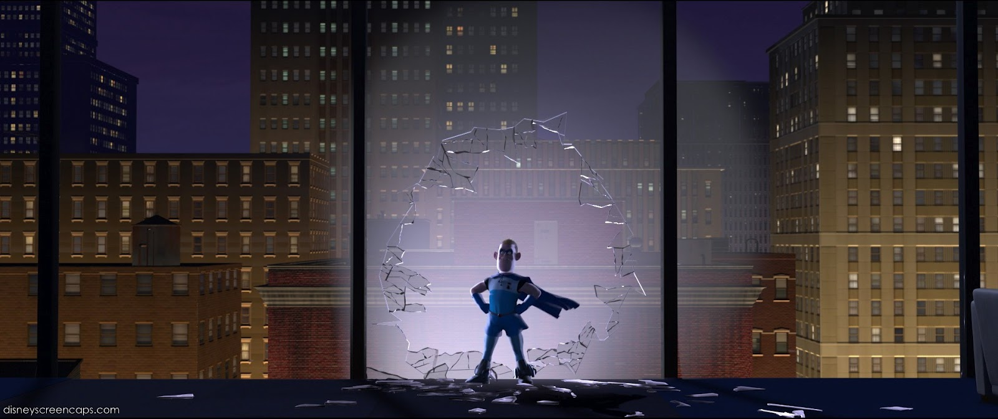
Prior to the “tragedy” that befell Buddy Pine (for which Bob was blamed), everyone assumed that Supers were infallible.

Slide 25
Infallible
Free from error; absolutely dependable

Slide 26
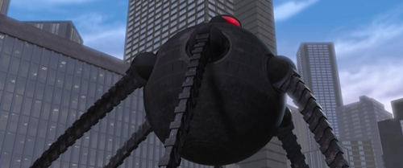
As the Omnidroid plodded through the city, it created destruction wherever it planted its heavy claws.

Slide 27
Plod
To walk heavily or slowly; to work slowly

Slide 28
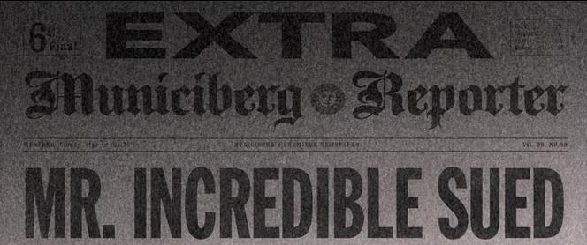
The pungent news stories mischaracterized Supers as reckless, selfish individuals that needed to be stopped.

Slide 29
Pungent
Causing a sharp sensation
Stinging, biting

Slide 30
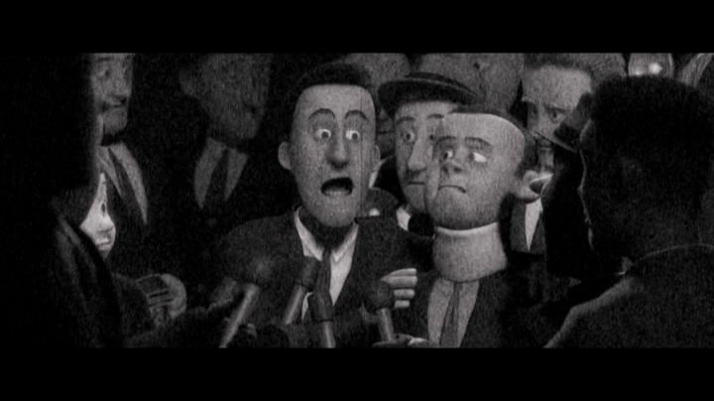
For the injuries of Buddy Pine, Bob was accused of being remiss in his duty to protect the public.

Slide 31
Remiss
Neglectful in performance of one’s duty, careless

Slide 32
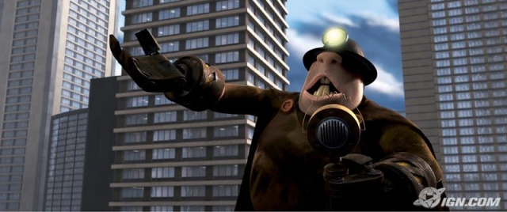
The Incredibles may have thought they would be able to repose after the capture of Syndrome, but the Mole soon appeared.

Slide 33
Repose
To rest, lie in place
Relaxation, peace of mind, calmness

Slide 34
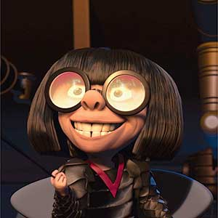
Edna Mode had the temerity to pronounce that Bob had “gotten fat.”

Slide 35
Temerity
Rashness, boldness

Slide 36
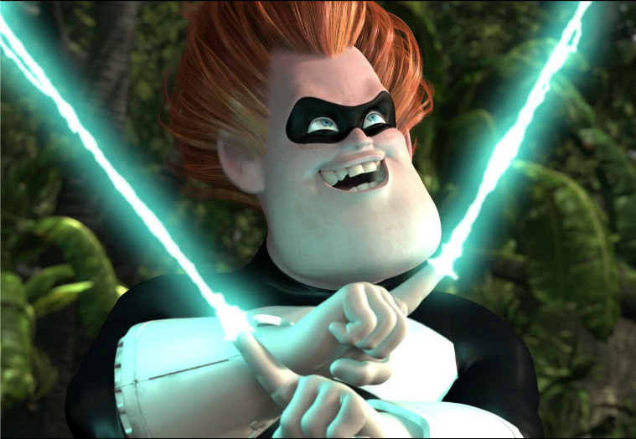
As a child, Buddy Pine may have wanted to become a Super and help people, but he grew into the truculent Syndrome who only wanted revenge, no matter the cost to others.

Slide 37
Truculent
Fierce and cruel; aggressive; deadly, destructive; scathingly harsh

Slide 38
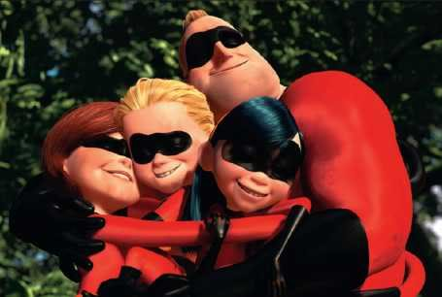
After the defeat of Syndrome, Supers were once again able to use their powers in an unfeigned manner.

Slide 39
Unfeigned
Sincere, real, without pretense

Slide 40
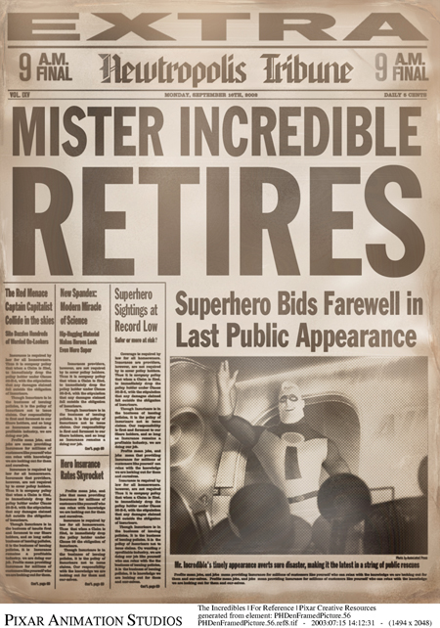
After the virulent gossip about him and other Supers, Mister Incredible decided to retire rather than endure any more of it.

Slide 41
Virulent
Extremely poisonous;
Full of malice
Spiteful

