Slide 1
TWP Pride Schedule Nuts and Bolts For Staff
Updated January 21, 2020
Notes:
Joe Bollendorf does general introduction about history of exploration.

Slide 2
Notes:
Jonathan

Slide 3
It’s not a block schedule, so what is it?
The new schedule is a unit lunch schedule with a rotating am wheel and a rotating pm wheel.
There will be a 4 day repeating cycle for our schedule.
2 Classes will not meet each day
1 Class will be dropped from the am wheel
1 Class will be dropped from the pm wheel each day
Notes:
Jonathan

Slide 4
What will the daily schedule look like?
Predictable Trends
The day in the cycle defines the class that starts the day.
Add 4 to the day in the cycle as a reminder of the first class to meet after TWP Time.
A class that meets 1st period does not meet the following day.
A class that meets 4th period does not meet the following day.
Notes:
Jonathan

Slide 5
“Class” Vs. “Period” Defined
CLASSES
The term “class” refers to the course assigned a number 1 – 8
Classes 1, 2, 3 and 4 will meet during the am wheel (with one of the four classes not meeting each day)
Classes 5, 6, 7 and 8 will meet during the pm wheel (with one of the four classes not meeting each day)
PERIODS
The term “period” refers to a time period during which instruction occurs
Period 1 will be 62 minutes each day to allow an additional 5 minutes for announcements or our “Wake Up TWP” show
Periods 2 and 3 will be 57 minutes each day in the am wheel
Periods 4, 5 and 6 will be 57 minutes each day in the pm wheel

Slide 6
Why?
Overall increase in instructional time of over 4,500 instructional minutes for the typical student
Opportunity for deeper learning with 12 minutes added to instructional periods
Every student will have a lunch period every day
Provides greater flexibility for student requests to be met
Opportunity for tutoring and academic interventions built into the school day
Improved overall school culture and climate for students and staff
162 minutes additional prep time for teachers every 4 days
Passing time cut from 40 minutes to 16 minutes
Improved attendance for students and staff
Notes:
Patti

Slide 7
A glimpse into what to expect during “Township Time” unit lunch….
Notes:
Patti

Slide 8
Teaching Schedule Basics In each 4 day cycle…
At least two twenty-eight (28) minute duty free lunch periods
Two fifty-six (56) minute duty free lunch periods
One twenty-eight (28) minute tutoring time at teacher’s discretion (with teacher notifying students and administration of the scheduling a week in advance)
One twenty-eight (28) minute TWP Time duty
Three fifty-seven (57) minute duty periods
Six fifty-seven (57) minute periods for instructional preparation, three in the morning and three in the afternoon

Slide 9
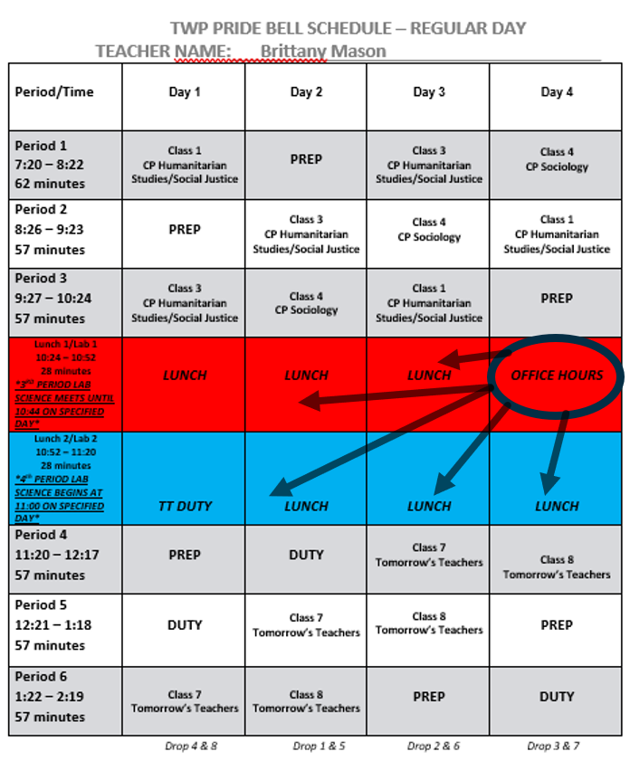
Sample Teacher Schedule (5 Sections)

Slide 10
How?
Ongoing professional development for teachers
Anticipate hiring of additional staff
Strategic reallocation and addition of support staff positions
Strategic assignment of all staff members during “TWP Time”
Addition of 4 new food service locations
Addition of 5 new eating locations
Budgeting for new furniture, additional trashcans, wipes, etc.
Notes:
Sav

Slide 11
What are the anticipated challenges?
Change
Reduced instructional time in lab science classes
Classes meet 3 out of every 4 days
No dedicated Homeroom period
Notes:
Sav

Slide 12
What about delayed openings?
Unit lunch remains 56 minutes
Instructional periods will be 37 minutes (42 for 1st period)
School day will still end at 2:19
What about early dismissals?
Unit lunch remains 56 minutes
Instructional periods will be 34 minutes (38 for 1st period)
School day will still end at 12:00
Notes:
Sav

Slide 13
How many courses can students take in the new schedule?
Incoming Freshmen will be expected to select 7 classes and a study hall
Incoming Freshmen will be able to request an 8th class similar to our current 8th class request process
Rising Sophomores and Juniors will be expected to select 8 classes
Rising Seniors will be expected to select 6 – 8 classes.
Rising Seniors will be permitted to select a maximum of 2 study halls and will therefore be scheduled for 30 credits
* We are currently working on a proposal for BOE approval that would change the required credits for graduation*
Rising Seniors – 120
Rising Juniors – 120
Rising Sophomores – 130
Rising Freshmen – 130
Notes:
Sav

Slide 14
How will staff and students know what day it is and what classes will meet on a given day?
Numbered days will help indicate which class meets first each day.
Day 1 = Class 1 (am wheel); Class 5 (pm wheel)
Day 2 = Class 2 (am wheel); Class 6 (pm wheel)
Day 3 = Class 3 (am wheel); Class 7 (pm wheel)
Day 4 = Class 4 (am wheel); Class 8 (pm wheel)
In the event of an emergency closing, the next school day will be the next numbered day in the cycle, thereby allowing for greater continuity in instruction.
We will communicate the day’s schedule through a variety of channels (social media, announcements before period 1, etc.) to assist students and staff, especially early in the year.
Notes:
Karin

Slide 15
How will science labs be scheduled?
Science labs will not be linked to health & physical education classes in our new schedule.
When a lab science class that meets during the am wheel occurs during 3rd period (9:27 – 10:24), students will remain in class until 10:44 (20 additional minutes into the unit lunch period).
When a lab science class that meets during the pm wheel occurs during 4th period (11:20 – 12:17), students will report to class at 11:00 (20 minutes early before the end of the unit lunch period).
Notes:
Karin

Slide 16
Notes:
Karin

Slide 17
Notes:
Karin

Slide 18
Will there still be senior privilege?
Seniors will still be permitted certain scheduling privileges that other grade levels won’t have access to.
Seniors will be permitted to take up to 2 study halls, which means they will still be scheduled for at least 30 credits.
When senior’s study hall occurs during 1st period, s/he will be permitted to arrive at 8:20 without penalty.
When as senior’s study hall occurs during 1st and 2nd period, s/he will be permitted to arrive at 9:20 without penalty.
When a senior’s study hall occurs during 6th period, s/he will be permitted to leave at 1:18 without penalty.
When a senior’s study hall occurs during 5th and 6th period, s/he will be permitted to leave at 12:17 without penalty.
Notes:
Jonathan

Slide 19
What is Option 2?
Option 2 serves as an alternative to traditional high school courses and involves in-depth experiences that allow students to earn high school credits while enrolled in a program outside of WTHS.
Seniors involved in an approved Option 2 program may be eligible to leave after the am wheel and unit lunch period (at 11:20 am) everyday. The following is a list of Option 2 programs that may qualify a student for a partial day program under Option 2.
Academy Internship (academy application required)
College Courses (Option 2 application required)
Business Co-Op (pre-requisites required)
Pre-Employment Mentoring (special education program)
Apprenticeship or Certification Programs (Option 2 application required)
Notes:
Jonathan

Slide 20
Notes:
Jonathan

Slide 21
Notes:
Jonathan

Slide 22
Notes:
Jonathan

Slide 23
Can students take more than one lab science in a year?
Yes. We will be better positioned to support students pursuing multiple lab sciences, since lab science classes will no longer be linked to health & physical education classes.
Notes:
Shaun

Slide 24
Where will food be served?
Cafeteria A
Cafeteria B
Cafeteria C
Cafeteria D
Auxiliary Gym
Core Lobby
IMC
B-20
These locations are expected to offer food service during period 3 and period 5 as well for students in study halls to purchase.
Notes:
Shaun

Slide 25
Where will students eat?
Cafeteria A
Cafeteria B
Cafeteria C
Cafeteria D
Auxiliary Gym (high top tables with no chairs)
9/10 Gym (bleachers behind the backboard only)
11/12 Old Gym (bleachers)
IMC
Quay Way
Classrooms (with teacher permission only)
Notes:
Shaun

Slide 26
How will areas be supervised during unit lunch?
Administrators will have areas that they will supervise each day for the entire unit lunch period.
Supervision Assistants will have areas that they will supervise each day for the entire unit lunch period.
School Resource Officers and School Security Personnel will have specific assignments for the entire unit lunch period.
Teachers will be assigned to assist in these areas
Notes:
Selby

Slide 27
What will students do during the 56 minute unit lunch?
Eat lunch
Connect with friends and classmates
Relax and decompress
Complete schoolwork, homework, etc. or read for pleasure
Seek additional help from teachers, counselors, CST members, etc.
Participate in meetings with clubs, sports teams, peer study groups etc.
Notes:
Selby

Slide 28
What will students not be permitted to do during unit lunch?
Students will not be permitted to leave campus.
Students will not be permitted to eat or congregate in the halls.
Students will not be permitted to be on the 2nd floor unless they are working in a classroom with a teacher.
Students will not be permitted to access any areas that are not supervised by staff (i.e. auditoriums, unsupervised classrooms, etc.)
Notes:
Selby

Slide 29
How will students know when teachers will be available for tutoring during unit lunch?
Teachers must be available for at least one 28 minute period of tutoring or additional support for students every four days.
Teachers are given some flexibility in scheduling their tutoring time so they can best support students.
Teachers will be required to keep their schedule up to date in their lesson plans and keep their schedule updated and posted outside their classroom so that students can have easy access to days/times when tutoring or additional support will be provided by teachers.
Notes:
Patti

Slide 30
Notes:
Patti

Slide 31
What additional measures are being taken to ensure student and school safety throughout the day?
We will continue to enforce current bathroom sign-in procedures.
The new schedule will allow for an increase in teacher supervision throughout the day.
As we do each year, we will be adding additional cameras throughout the building.
Quay Way
Auxiliary Gym
Other Strategic Locations
Notes:
Jonathan

Slide 32
What supports will be in place for students with special needs?
We will continue to provide support for students with disabilities that need specific assistance during their lunch period in accordance with the student’s IEP
Child Study Team members, School Counselors and SAC’s will be available to assist students during the unit lunch as needed
A section of our IMC will be designated as “Nut Free” to provide a safe space for students with severe nut allergies to eat

Slide 33
Where do students report during an emergency evacuation?
For emergency evacuations that occur during one of the instructional periods, students must report to the area designated for that class/teacher as they’ve always done.
For emergency evacuations that occur during TWP Time, students must exit via the closest door and move to the quadrant assigned for that day’s 3rd period class.
Notes:
Jonathan

Slide 34
What is restricted lunch?
Restricted lunch will occur in specific classrooms in both the 9/10 and 11/12 wings each day.
Restricted lunch will replace our current after school administrative detentions.
Any student that is acting inappropriately during unit lunch will be sent to restricted lunch immediately for the remainder of that day’s unit lunch period and may be assigned additional days of restricted lunch.
Notes:
Jonathan

Slide 35
How will the custodians be able to keep up?
Each of our eating locations will have ample trash and recycling containers. Wipes will be abundant as well, as students will be coached and expected to keep all areas clean at all times. Staff that supervise the various eating locations will play a critical role in assisting our custodians by reminding students of the importance of cleaning up after themselves and reporting concerns to administration.
*Any staff allowing students to eat lunch in their classroom must insist that students properly dispose of their trash in the regular eating areas.
Custodians will have to work strategically during the unit lunch to stay on top of trash disposal, primarily. Custodians will need to prioritize cleaning the following areas that will be used for instruction immediately following unit lunch:
IMC
Gyms
Notes:
Staff Meeting Only

Slide 36
How will the kids be prepared to adjust?
Class presentations for all students in grades 9-11 (February)
Grade level assembly for all 8th graders (March)
Freshmen summer transition program activities
Short animated videos embedded in “Wake Up TWP” show Wednesdays and Fridays
Grade level assemblies for all students in grades 9-12 (September)
Social media reminders, emails, etc.
Notes:
Jonathan

