Slide 1
Welcome Back!
Please take a seat in a chair that has a T-Shirt. Don’t worry about the size – you can trade it in later. Check underneath your seat. If you’ve won a prize, start dancing!

Slide 2
Welcome to the High School Family
Teachers
Kristen Bentley – Special Education
Heather Cicero – Math
Colleen Clement – Special Education
Kristen Dirato – Technology Education
Kyle Falzone – Technology Education (Transfer from CRMS)
Jim Hassett – Special Education
Ian Hoblitzell – Orchestra (Transfer from Elementary Schools)
Jennifer Sedlak – Child Study Team
Jessica Tanski – Adaptive Phys. Ed.
Jessica Waller – English (Transfer from CRMS)

Slide 6
FOCUS
WTPS FOCUS
Marzano Focused Teacher Evaluation Model

Slide 7
Teacher Overview
Review of the Focused Teacher Evaluation Model
The WTPS vision for FTE Model
What’s New in the Model
What’s Unique to WTPS
Questions and Answers (Q & A)

Slide 8
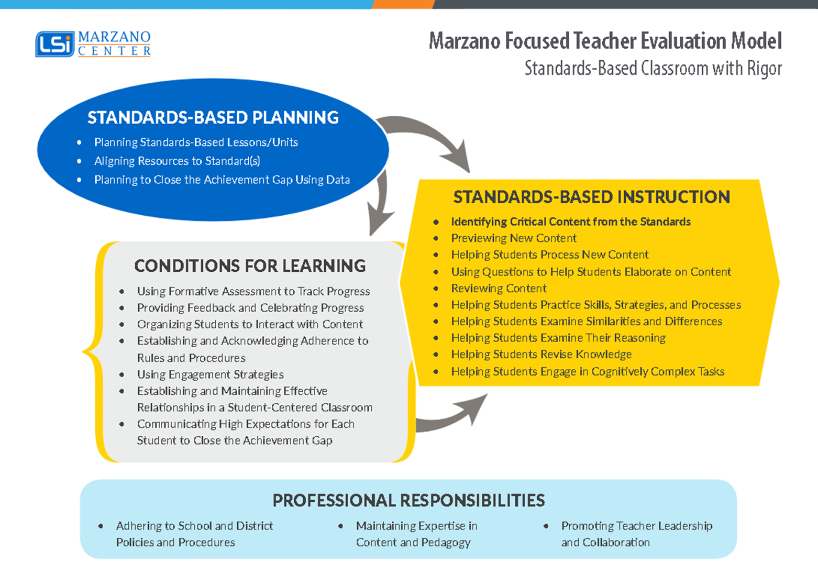

Slide 9
The WTPS Vision for the
Marzano Focused Teacher Evaluation Model
Our vision of the new model is simply to use the tool to improve teaching and learning. Our main areas of focus center around the following questions:
Is the learning target tied to the standards (or individual student goals) ?
Is the critical content at the taxonomy level of the learning target (objective)?
Are the lesson activities aligned to the taxonomy level of the learning target?
Are the bulk of the activities teacher-centered or student-centered? Student-centered leads to RIGOR.
Is the teacher using formative assessments and/or monitoring strategies to determine individual student progress toward the learning target?
Is the teacher using this data to drive his/her instruction? How?

Slide 10
WTPS Focus
What is New?
What is Unique?

Slide 11
What is New?
A focus on standards-based learning targets /objectives
What do you want students to know and/or be able to do as a result of the lesson?

Slide 12
What is New?
A focus on standards-based learning targets / objectives
Embedded within a performance scale
AND / OR
Organized in a logical learning progression through the scope and sequence of a unit
AND / OR
Organized in a logical learning progression within an individualized learning plan

Slide 13
What is New?
An alignment between the taxonomy level of the
learning target/objective and the activities and tasks in
the lesson.
THIS IS RATED IN CRITICAL CONTENT

Slide 14
What is New?
Identifying Critical Content from the Standards
REQUIRED TO BE RATED
THIS WILL NOT BE RATED AFTER THE FIRST OBSERVATION. THE TEACHER WILL ONLY RECEIVE COMMENTS ON THIS NEW FOCUS UNTIL THE SECOND OBSERVATION.
Soft Launch

Slide 15
What is New?
IDENTIFYING CRITICAL CONTENT FROM THE STANDARDS
If the lesson activities do not meet the taxonomy level of the learning target, the highest score for this element is a BEGINNING.
AND/OR
If the lesson is not aligned to an appropriate learning target/standard, the the highest score for this element is a BEGINNING.

Slide 16
What is New?
Student evidence (formative data) is shared with the observer at the post conference to show the percentage of students who met the learning target/objective.
THIS IS INDICATED IN THE SCALE FOR STANDARDS-BASED INSTRUCTION

Slide 17
What is New?

Slide 18
What is New?
The Focused Evaluation Teacher Model recommends collecting tangible student evidence to determine if the desired effect is displayed in the majority of the student evidence at the taxonomy level of the critical content.
(e.g, evidence that shows the percentage or approximate number of students who met the learning target).

Slide 19
What is Unique to WTPS?
Evidence of meeting the learning target/objective will only be used for ONE element/strategy in Standards-Based Instruction. (Even though this is listed in scale for the entire domain.)

Slide 20
What is Unique to WTPS?
Evidence of meeting the learning target/objective will only be used for ONE element or strategy in Standards-Based Instruction.
The observer will rate the priority element/strategy used in Standards-Based Instruction designed to best meet the learning target.

Slide 21
What is Unique to WTPS?
The ONE priority element cannot be rated until the post conference. At the post conference, the teacher will bring student evidence to show that students met the learning target.
(e.g., Exit slips, online formative assessment data, written work, etc.)
THIS WILL NOT BE RATED AFTER THE FIRST OBSERVATION. THE TEACHER WILL ONLY RECEIVE COMMENTS ON THIS NEW FOCUS UNTIL THE SECOND OBSERVATION.
Soft Launch

Slide 22
What is Unique to WTPS?
The remaining elements in STANDARDS- BASED INSTRUCTION will be rated the same way as in the previous model.
DID STUDENTS ACHIEVE THE DESIRED EFFECT?
To be INNOVATING, 90% of the students need to meet the desired effect instead of 100%.

Slide 23
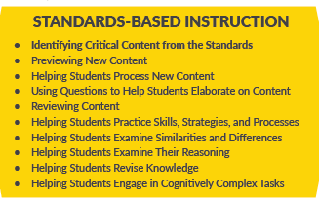
Three Main Shifts
1
2
3
THE PRIORITY ELEMENT IS WHERE THE STUDENTS SPEND MOST OF THE LESSON ON THE LEARNING TARGET/OBJECTIVE. THIS ELEMENT WILL REQUIRE EVIDENCE/DATA SHOWING THE PERCENTAGE OF STUDENTS WHO MET THE DAILY LEARNING TARGET/OBJECTIVE.

Slide 24
Questions and Answers
How is the instructional practice score calculated?
The DEAC approved averaging all elements scored. All elements and domains are equally weighted.
Will all elements be rated?
It is recommended to score all elements over the course of the year, but it is not required. Only scored elements will be applied to the overall evaluation score. Observers may also comment on an element without formally rating an element.

Slide 25
Questions and Answers
How many “domains” are rated during each observation?
It is expected that each domain should have minimally one element rated during each observation. The domain of professional responsibilities will also be rated at the summative evaluation.
Are there required pre / post conference forms?
There are recommended forms for pre-conferences. The pre-conference form should be completed and submitted by the teacher after he or she is notified of the observation. Staff will have time to adjust to this process. The post conference form is a list of potential discussion points which may occur.

Slide 26
Questions and Answers
Should teachers inform the observer of the priority element / strategy prior to the evaluation?
No. Teachers may need to make adjustments on the spot based on formative data and monitoring techniques. Therefore, the priority strategy could shift, and teachers are encouraged to make these changes to support their students.
Should learning targets/objectives be posted?
Learning targets/objectives should always be stated orally; however, they should also be posted when they are applicable to the entire class.

Slide 27
Questions and Answers
How many standards should be linked to the daily lesson?
Teachers may link the standards applicable to the unit or mini-unit sequence in OnCourse. However, the essential learning target / objective should be indicated for each day within the lesson plan.
What if the observed lesson differs from the written plan?
Teachers should be able to show the progression of learning in their plans. If the teacher can demonstrate a logical progression and explain a rationale as to why / how the learning target or activities differed from the plan, this will not impact the rating.

Slide 28
New Initiatives at the High School
Cohort Model for Staff Meetings
No Place for Hate
Learning Walks
Praise Referrals (Staff and Students)

Slide 29
